Slide 1
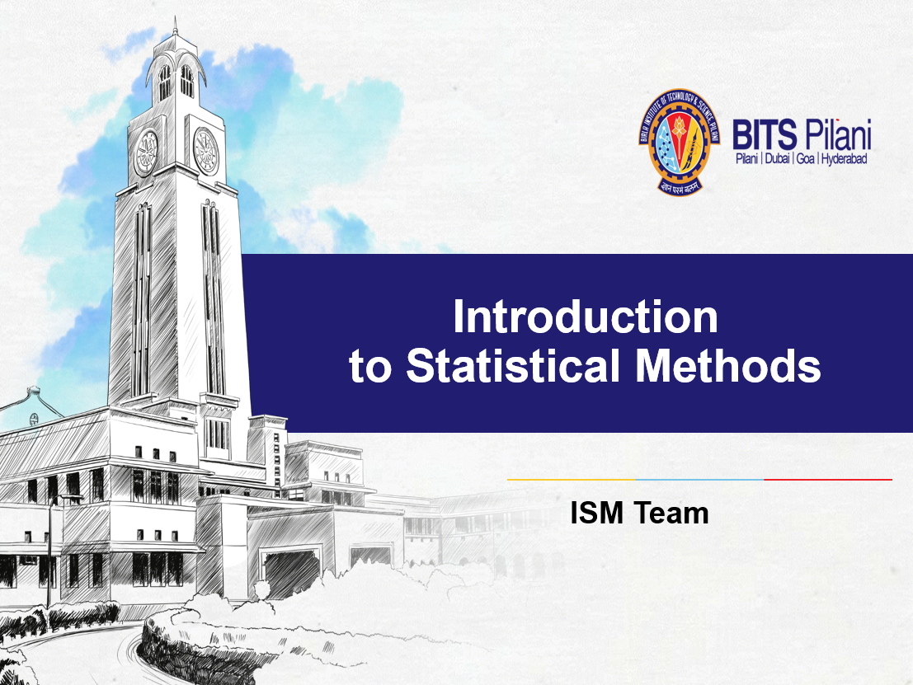

Slide 2

Session No: 9
Testing of Hypothesis
(5th /6th Aug ,2023)

Slide 3
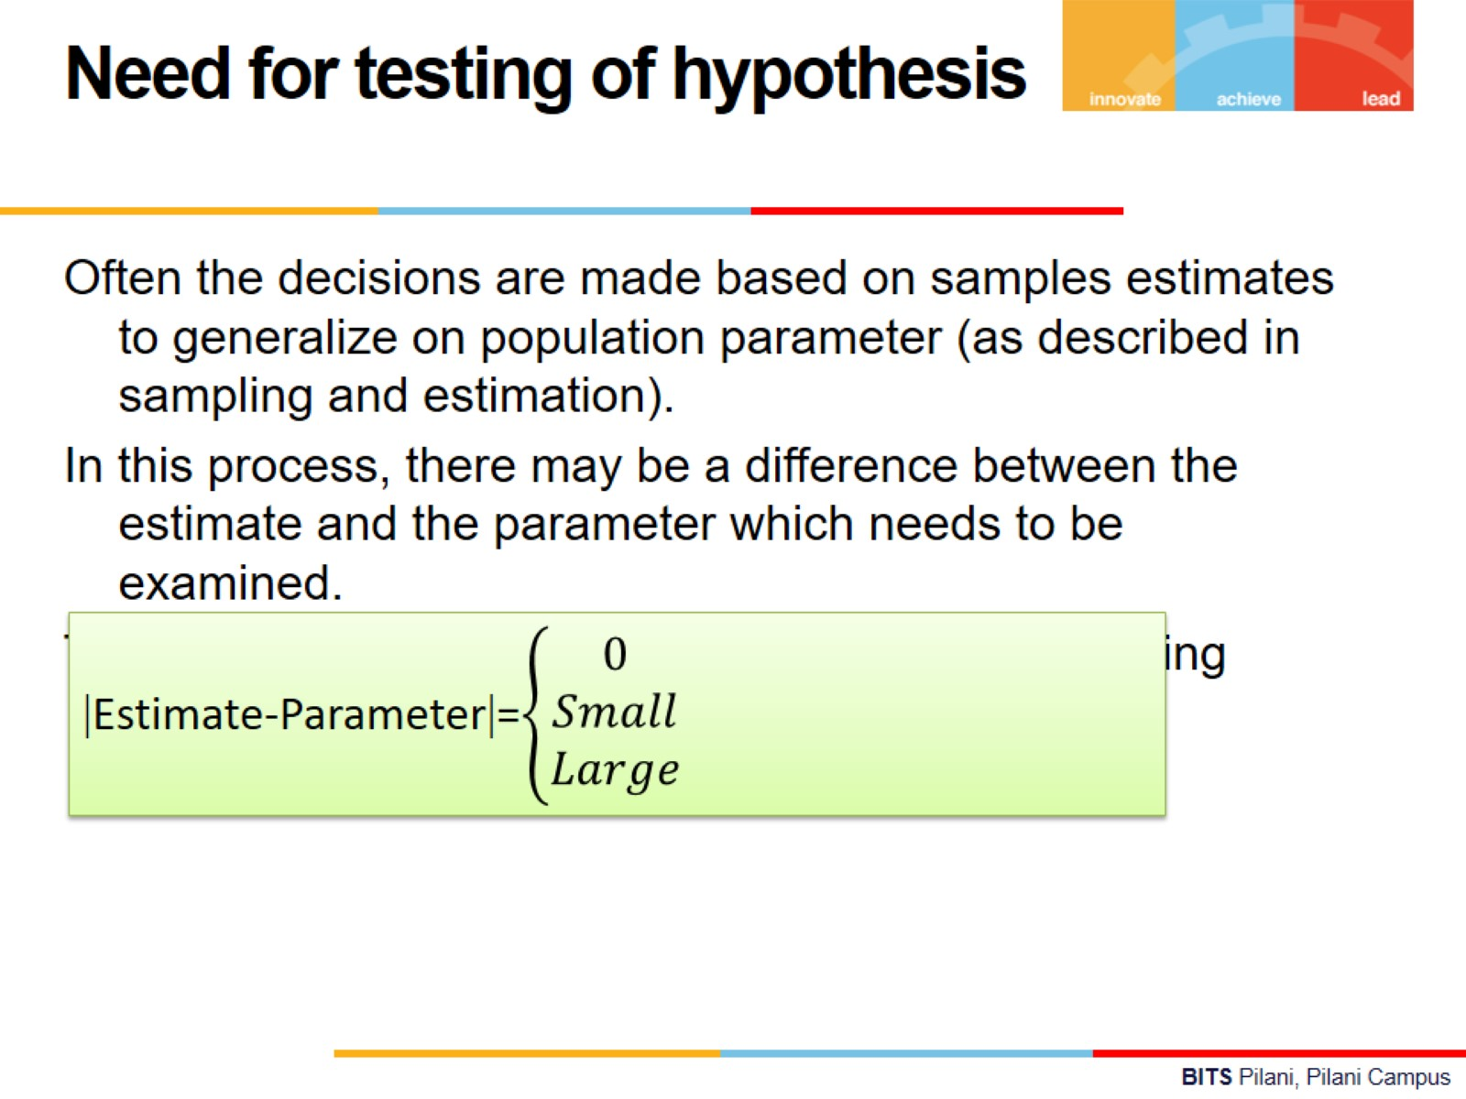

Slide 4
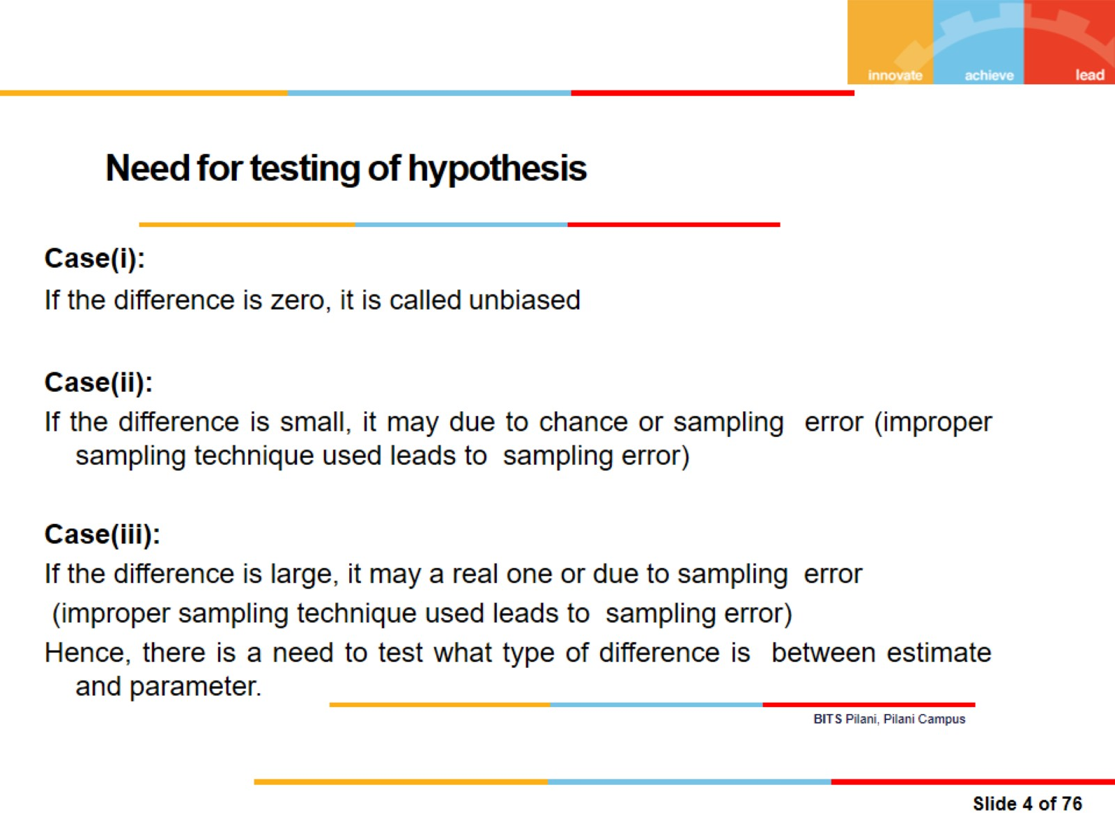
Need for testing of hypothesis

Slide 5
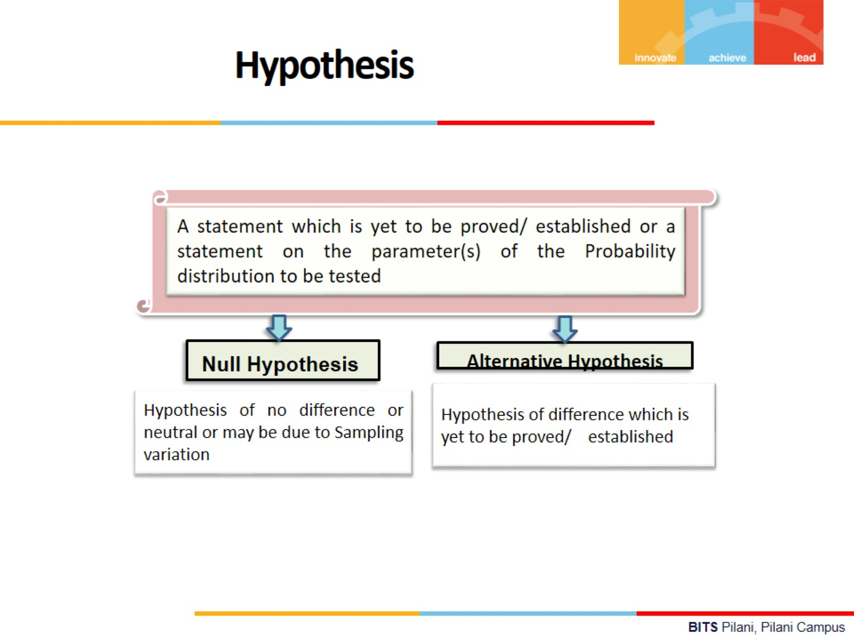

Slide 6
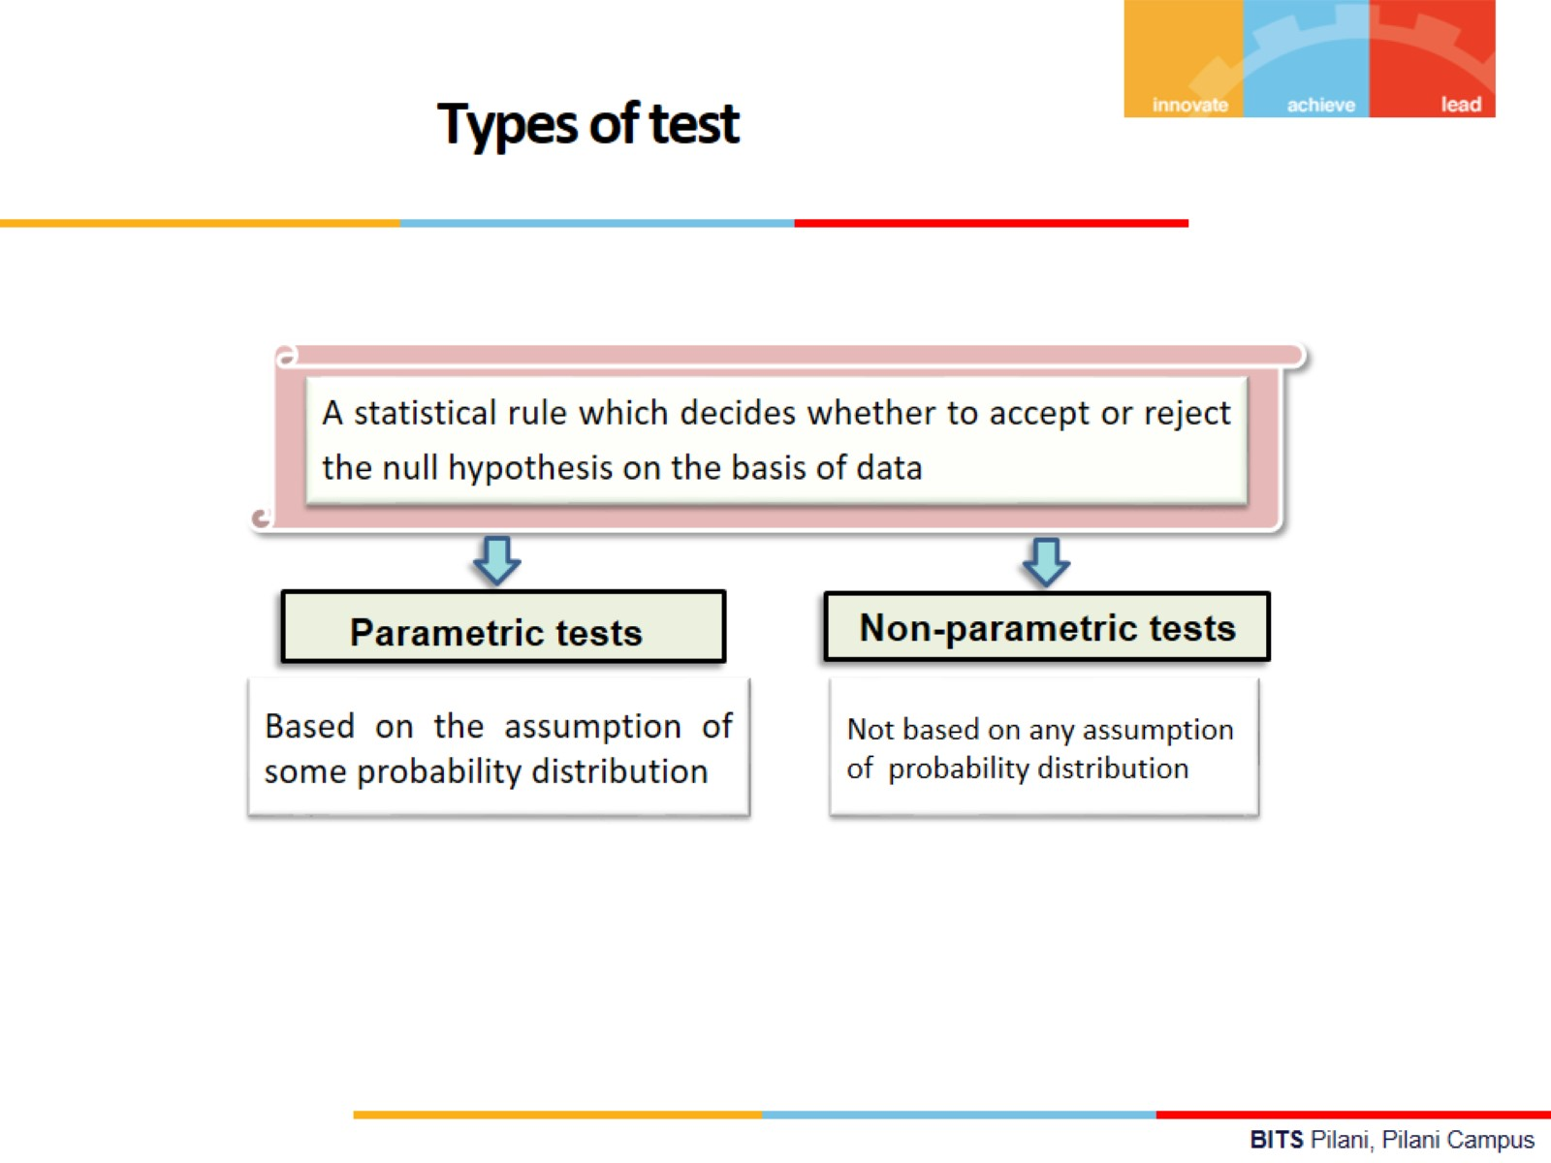

Slide 7
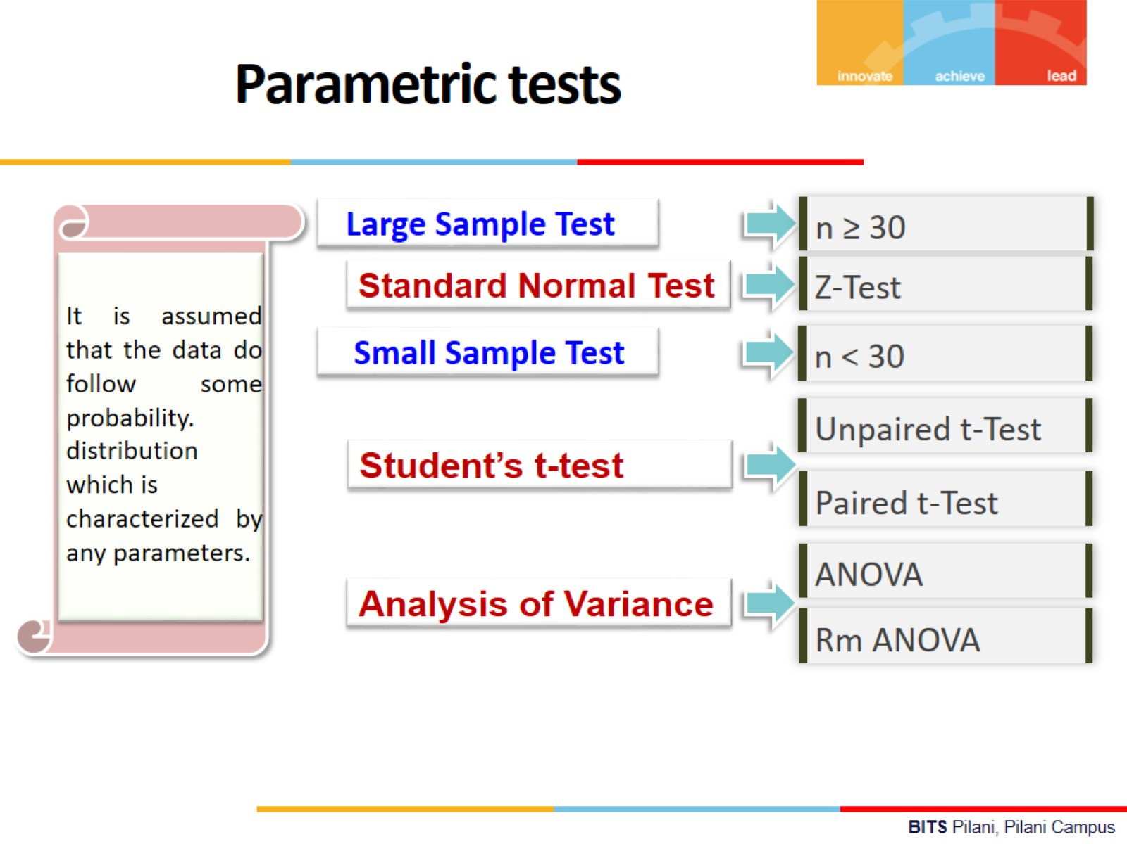

Slide 8
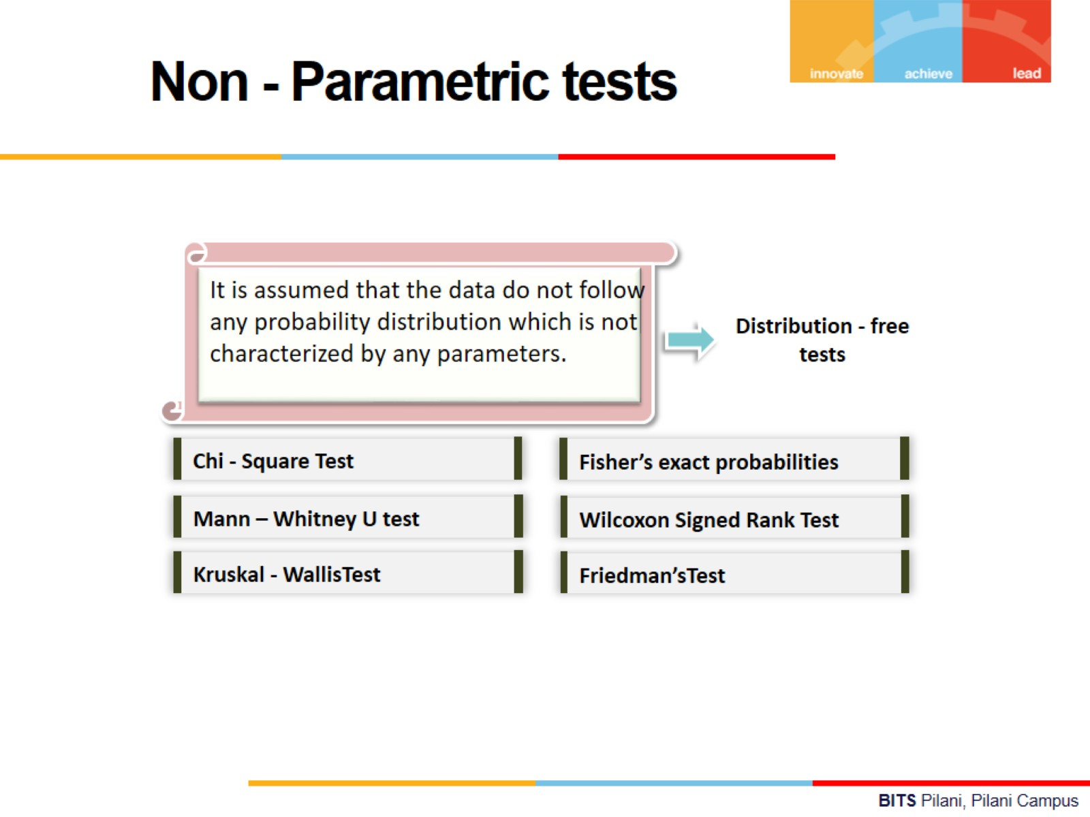

Slide 9
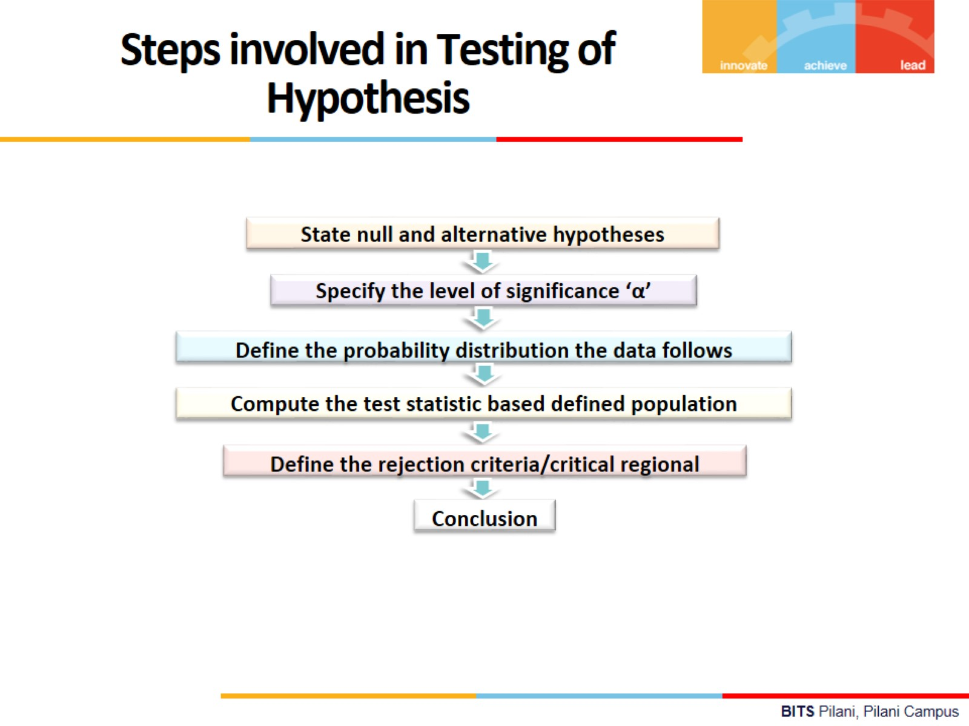

Slide 10
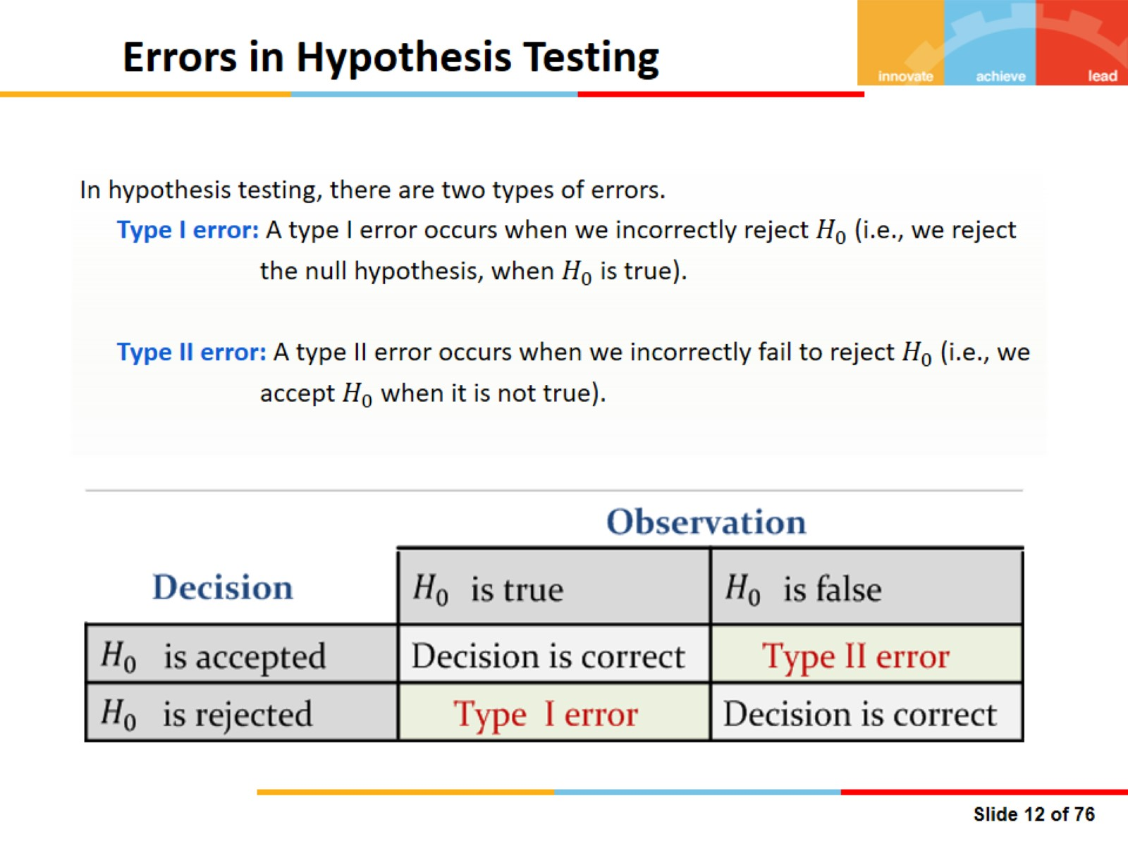

Slide 11
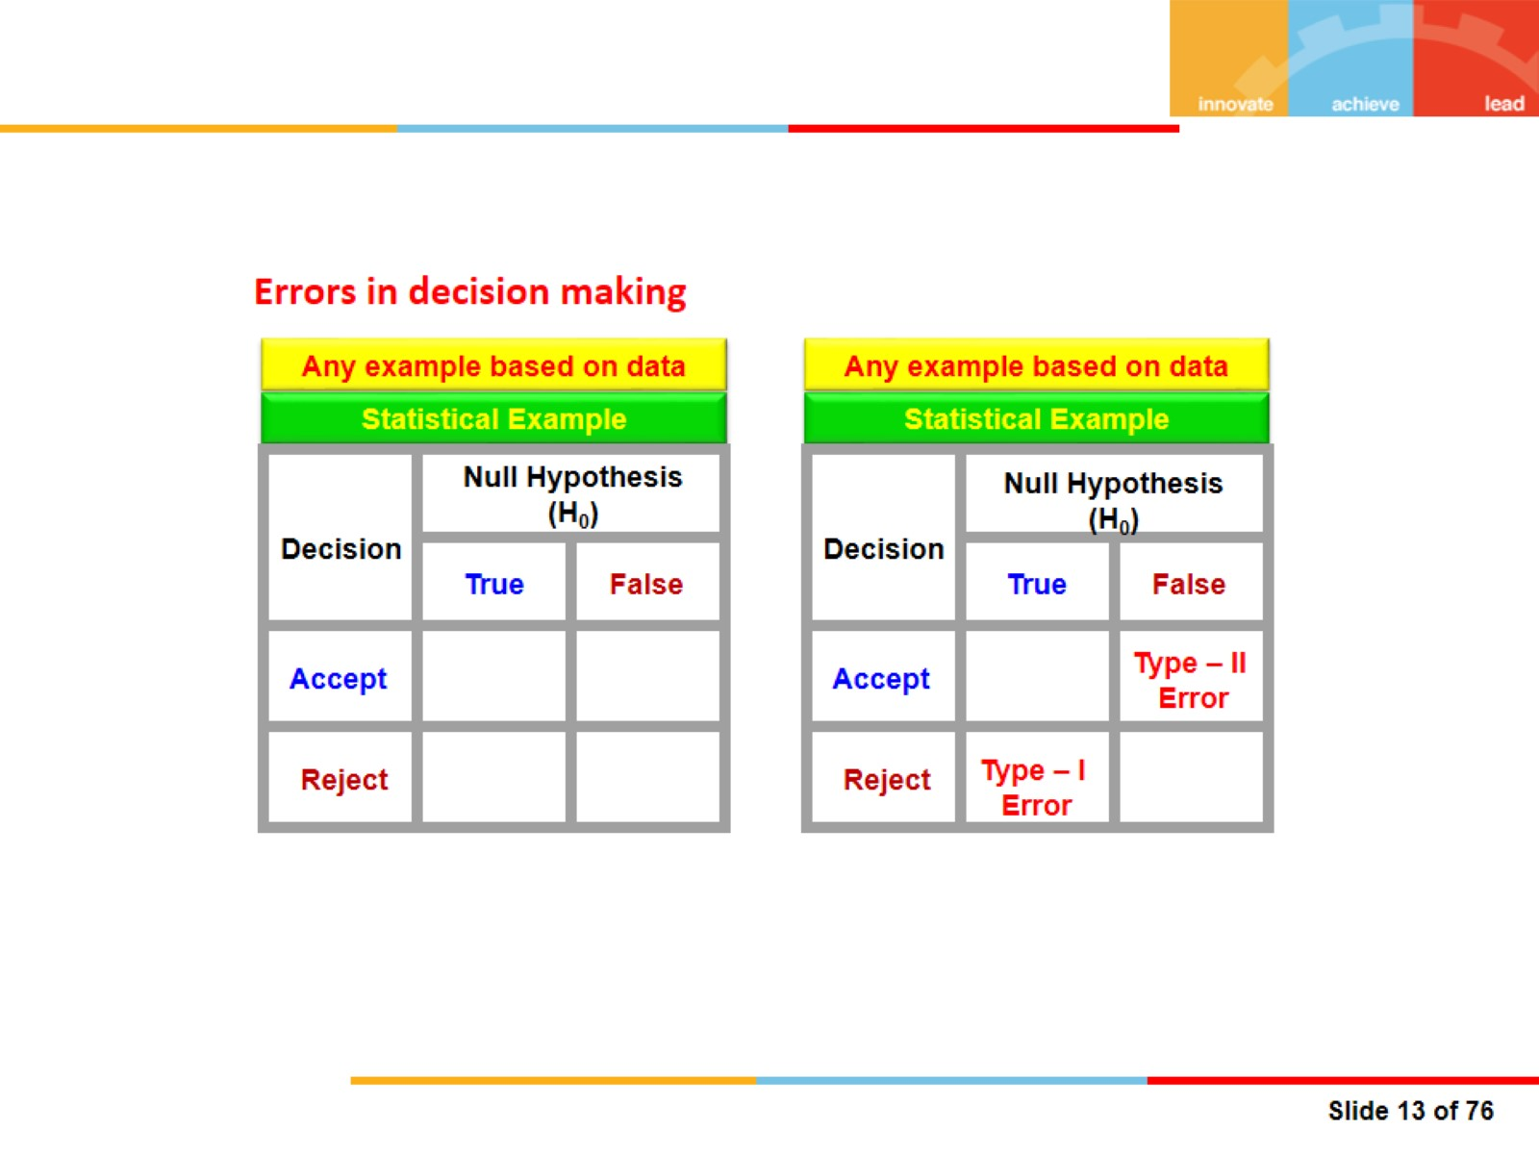
Errors in decision making

Slide 12
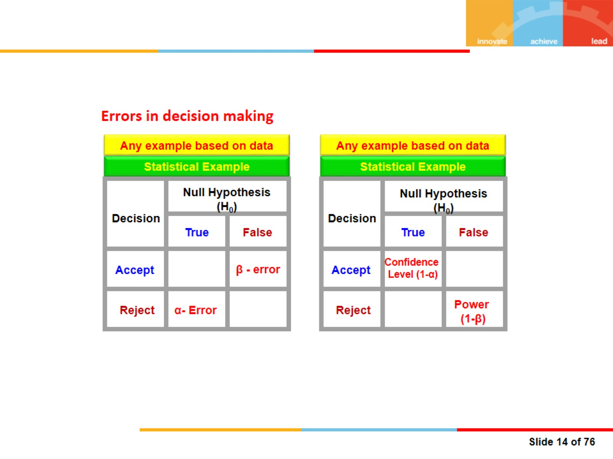
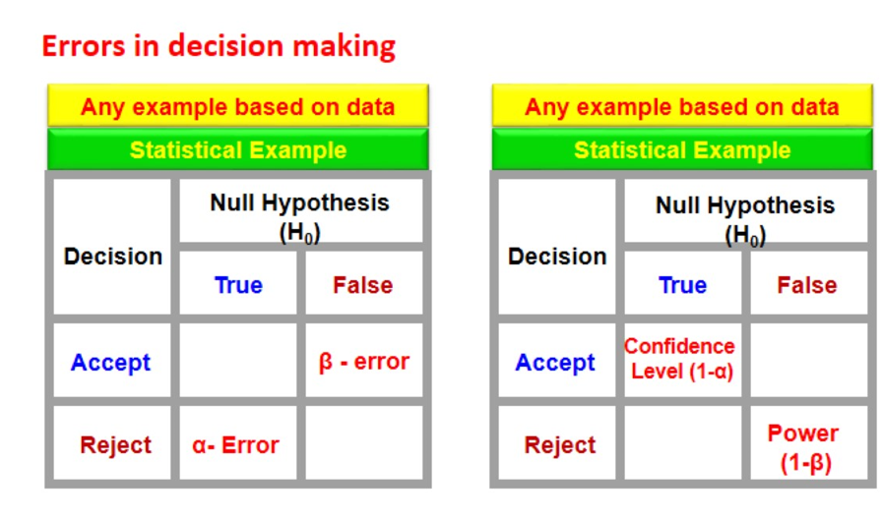
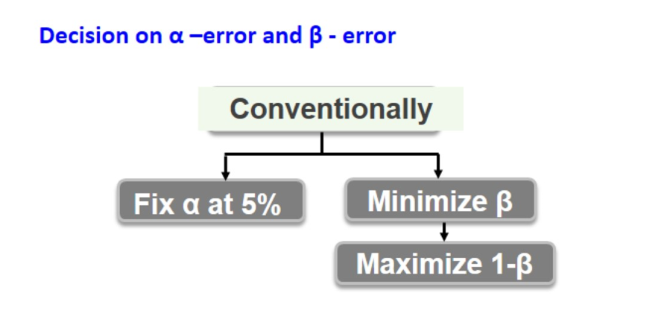
Errors in decision making

Slide 13
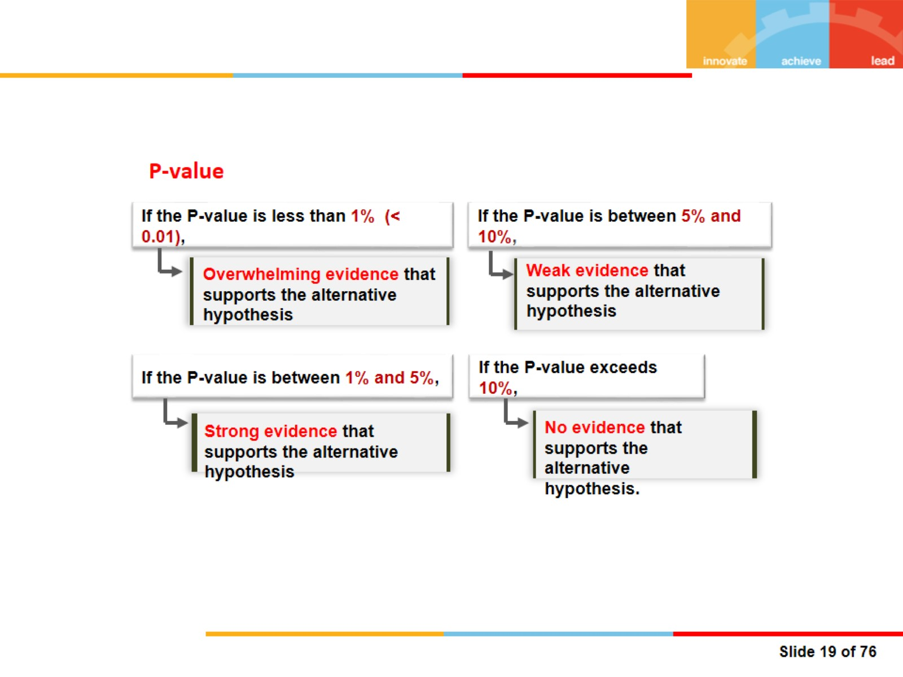

P-value

Slide 14
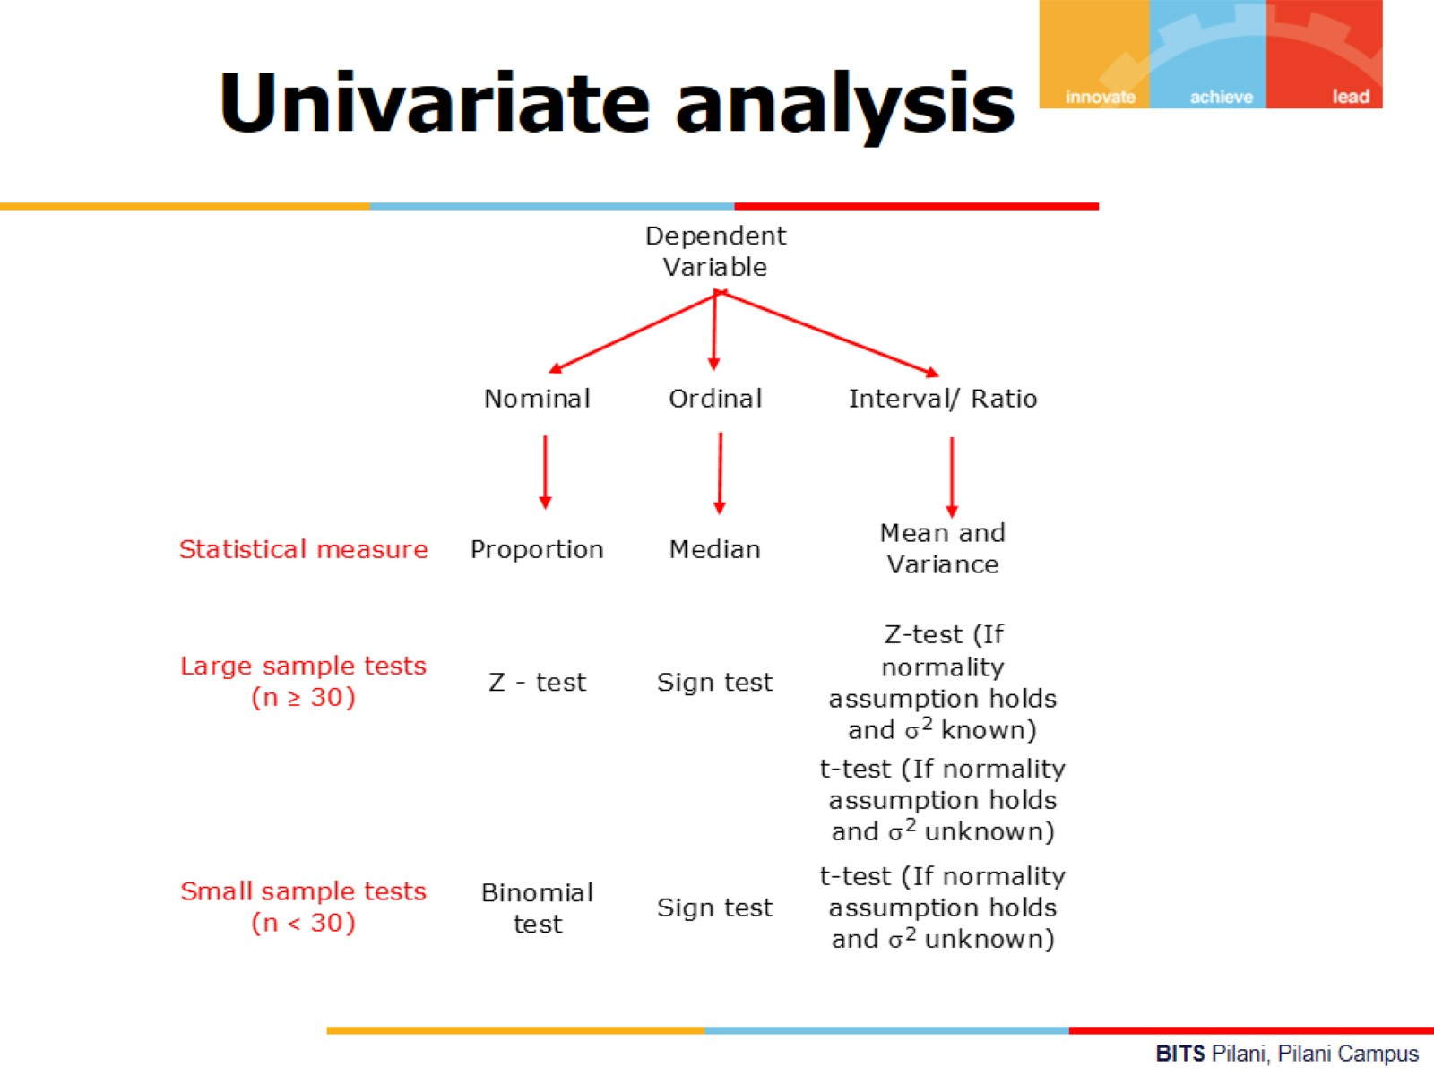

Slide 15
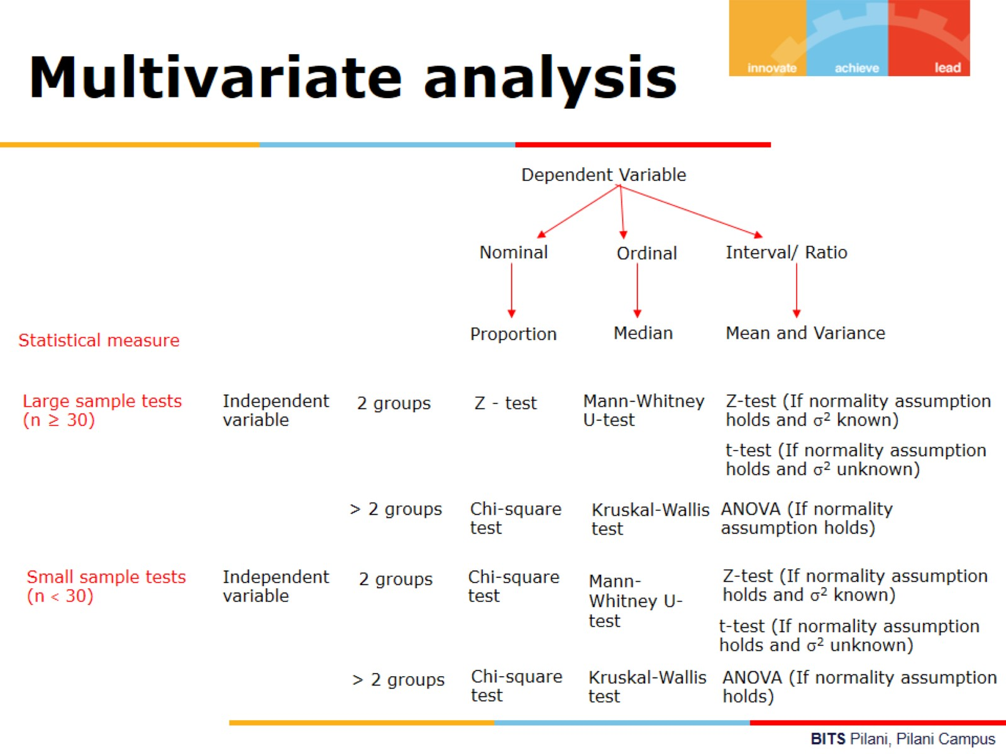

Slide 16
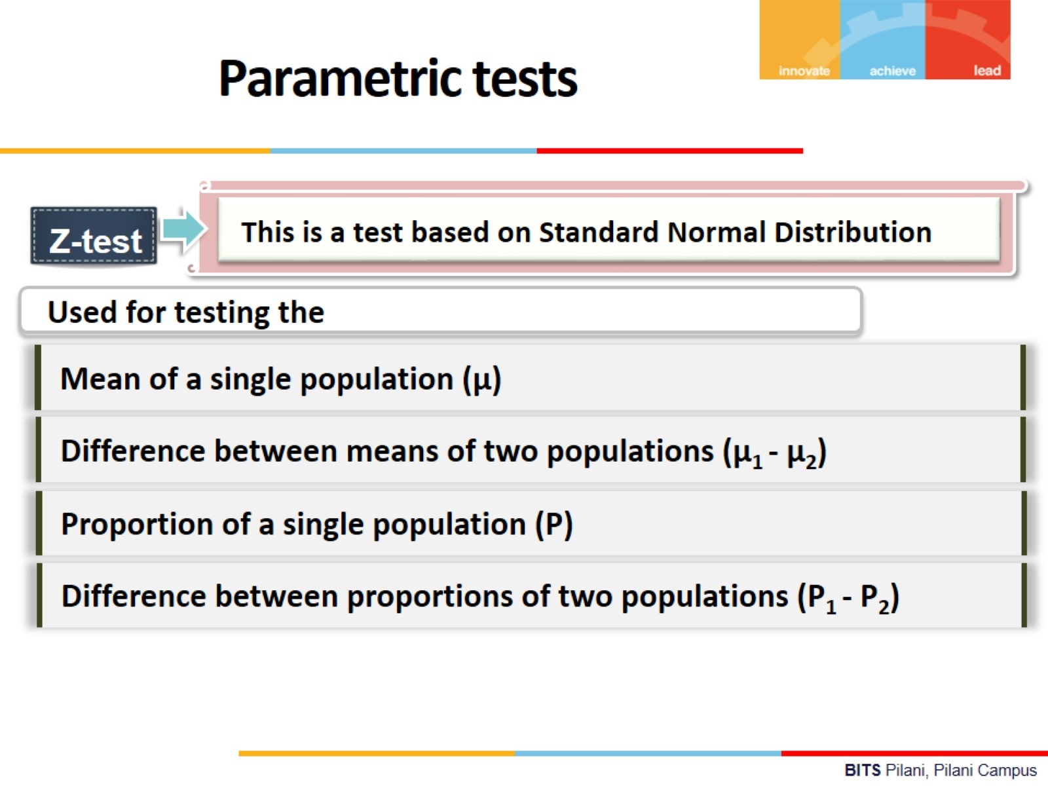

Slide 17
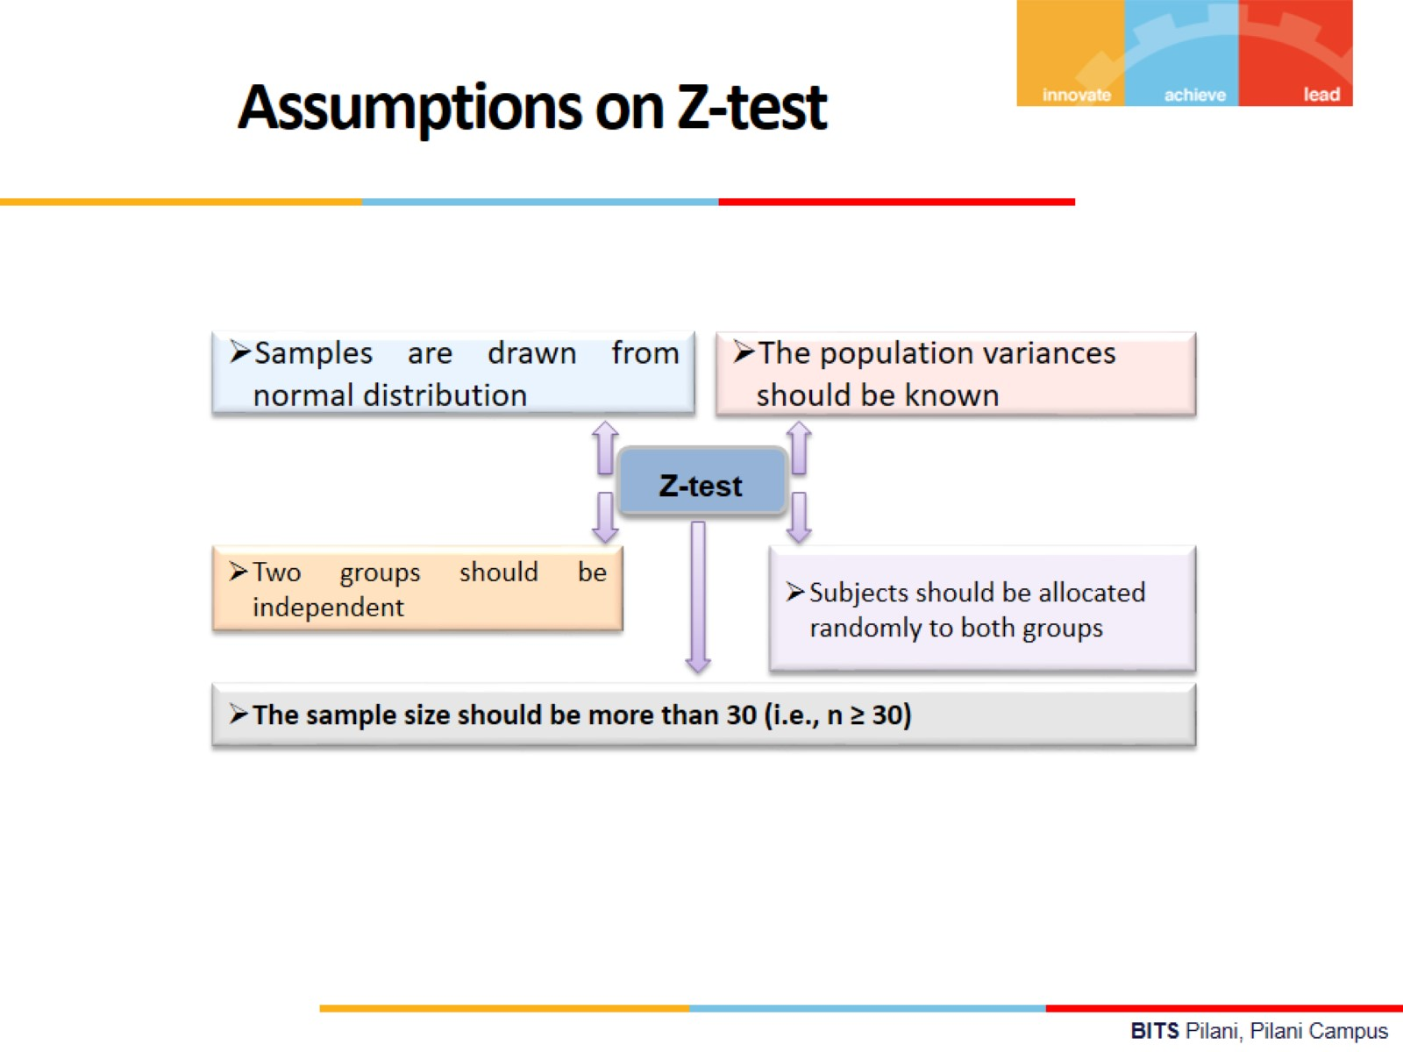

Slide 18
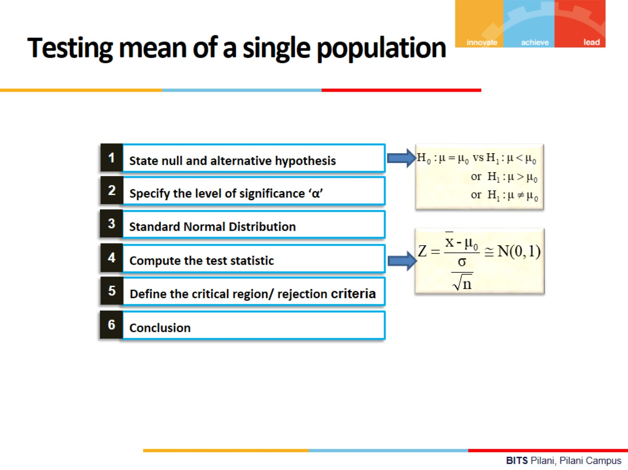

Slide 19
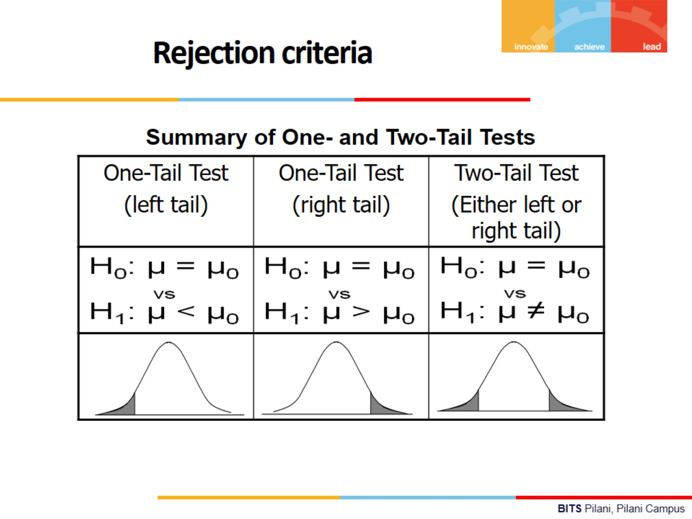

Slide 20


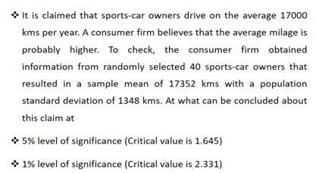
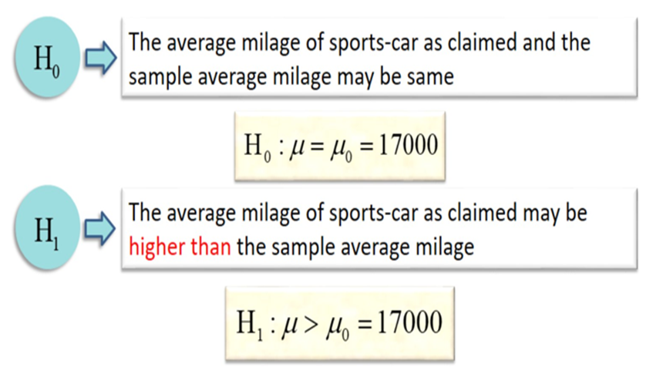

Slide 21
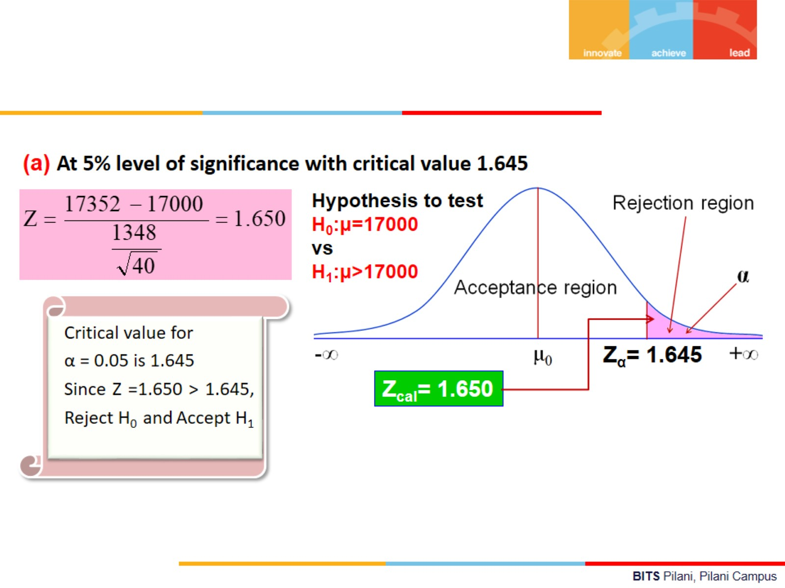

Slide 22
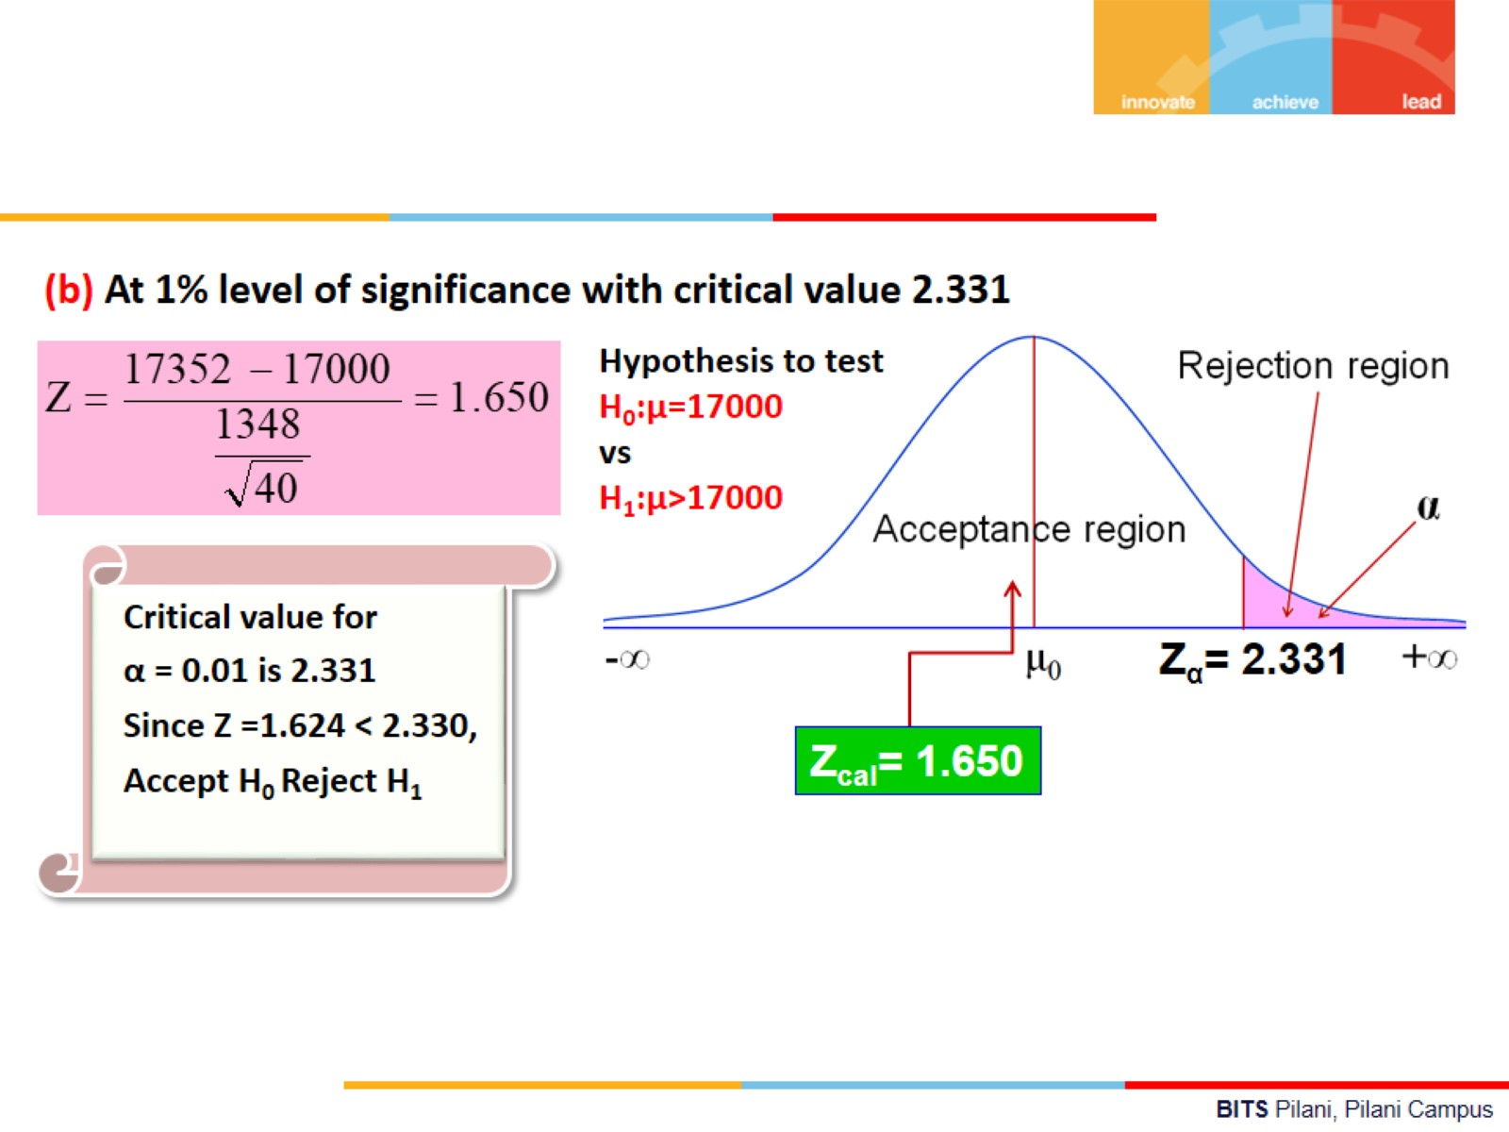

Slide 23

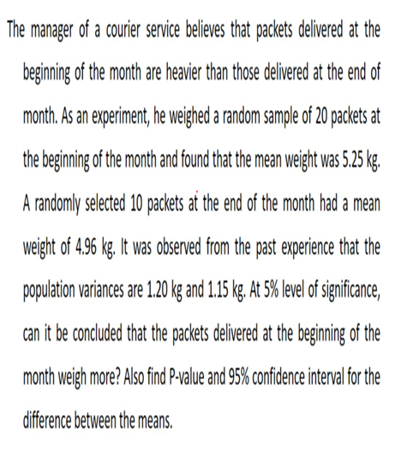
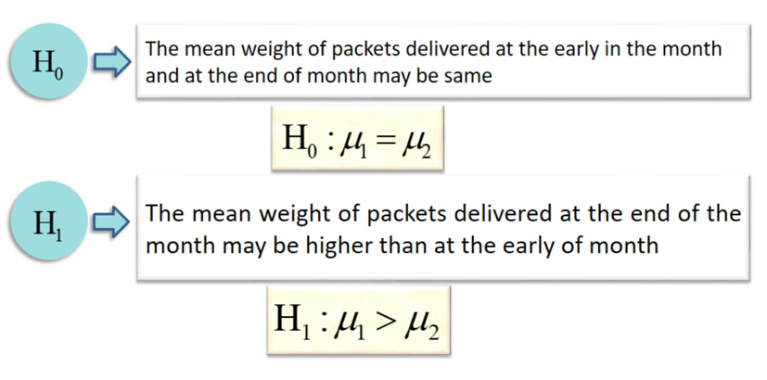
Example:2

Slide 24
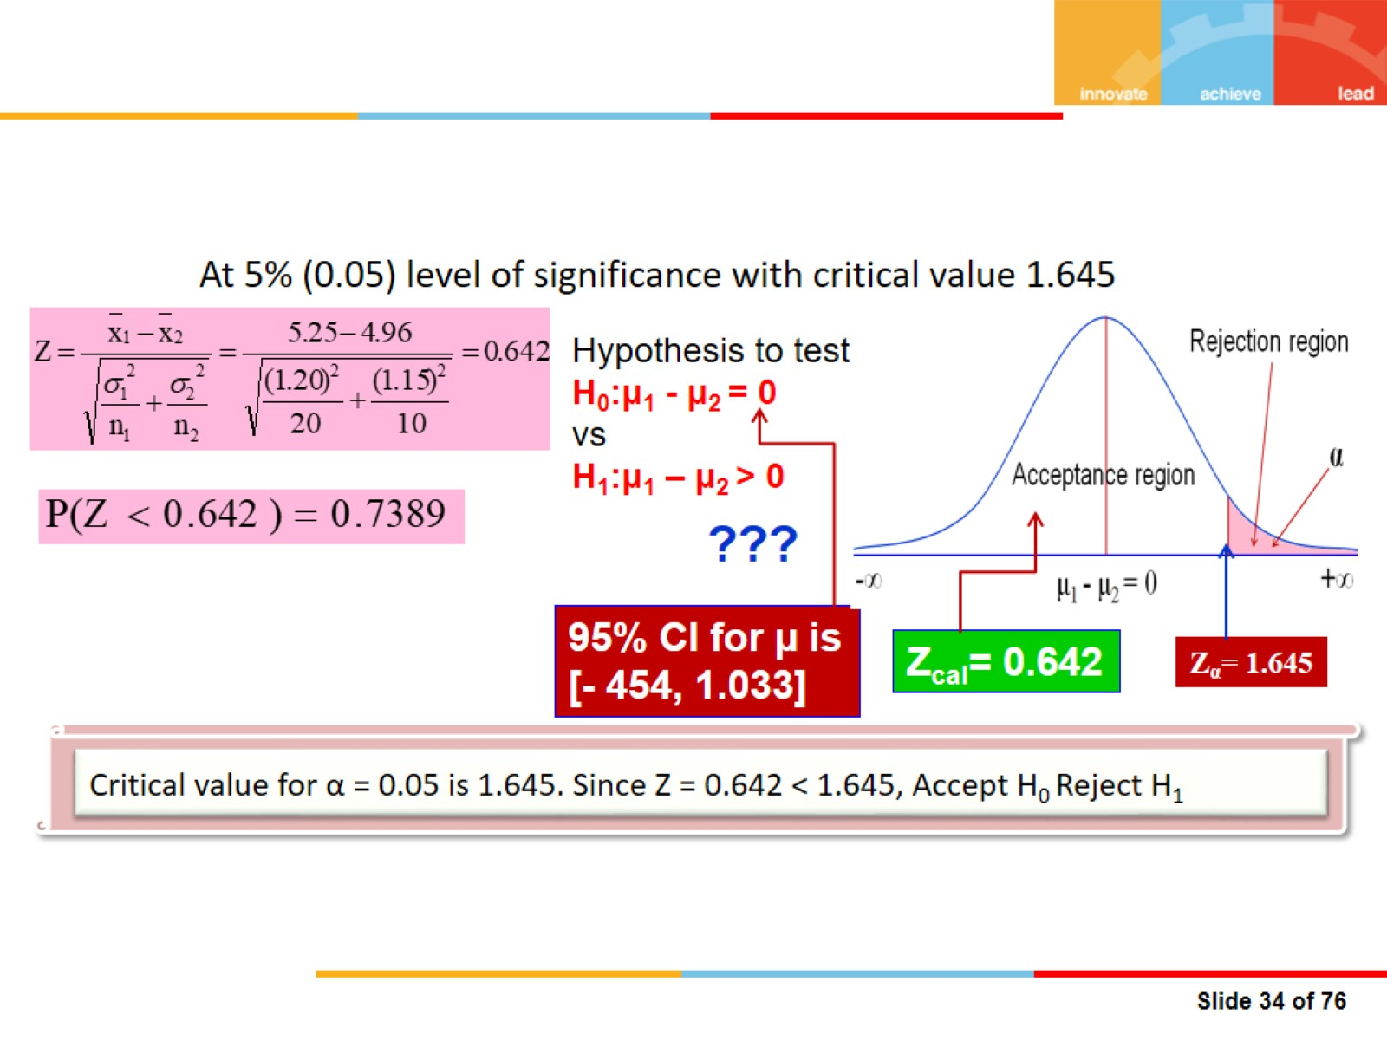

Slide 25
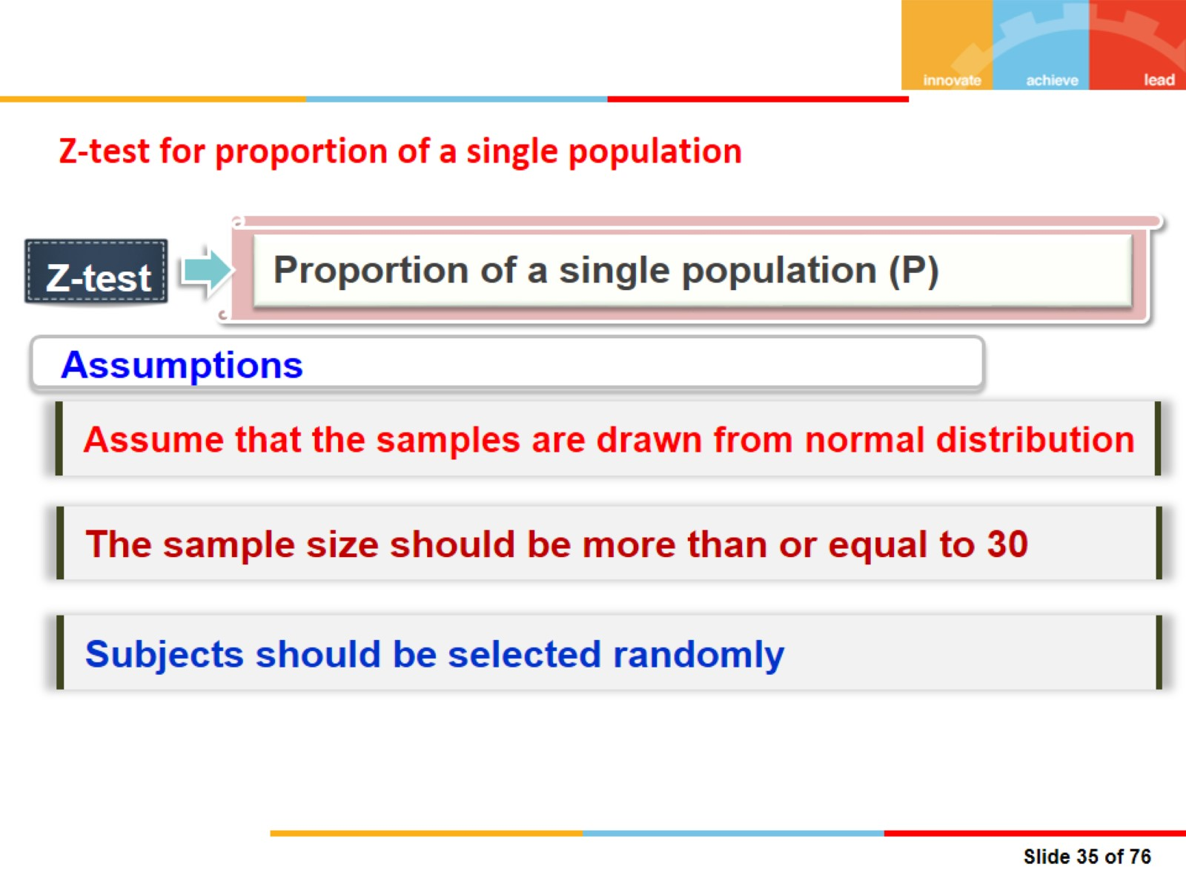
Z-test for proportion of a single population

Slide 26
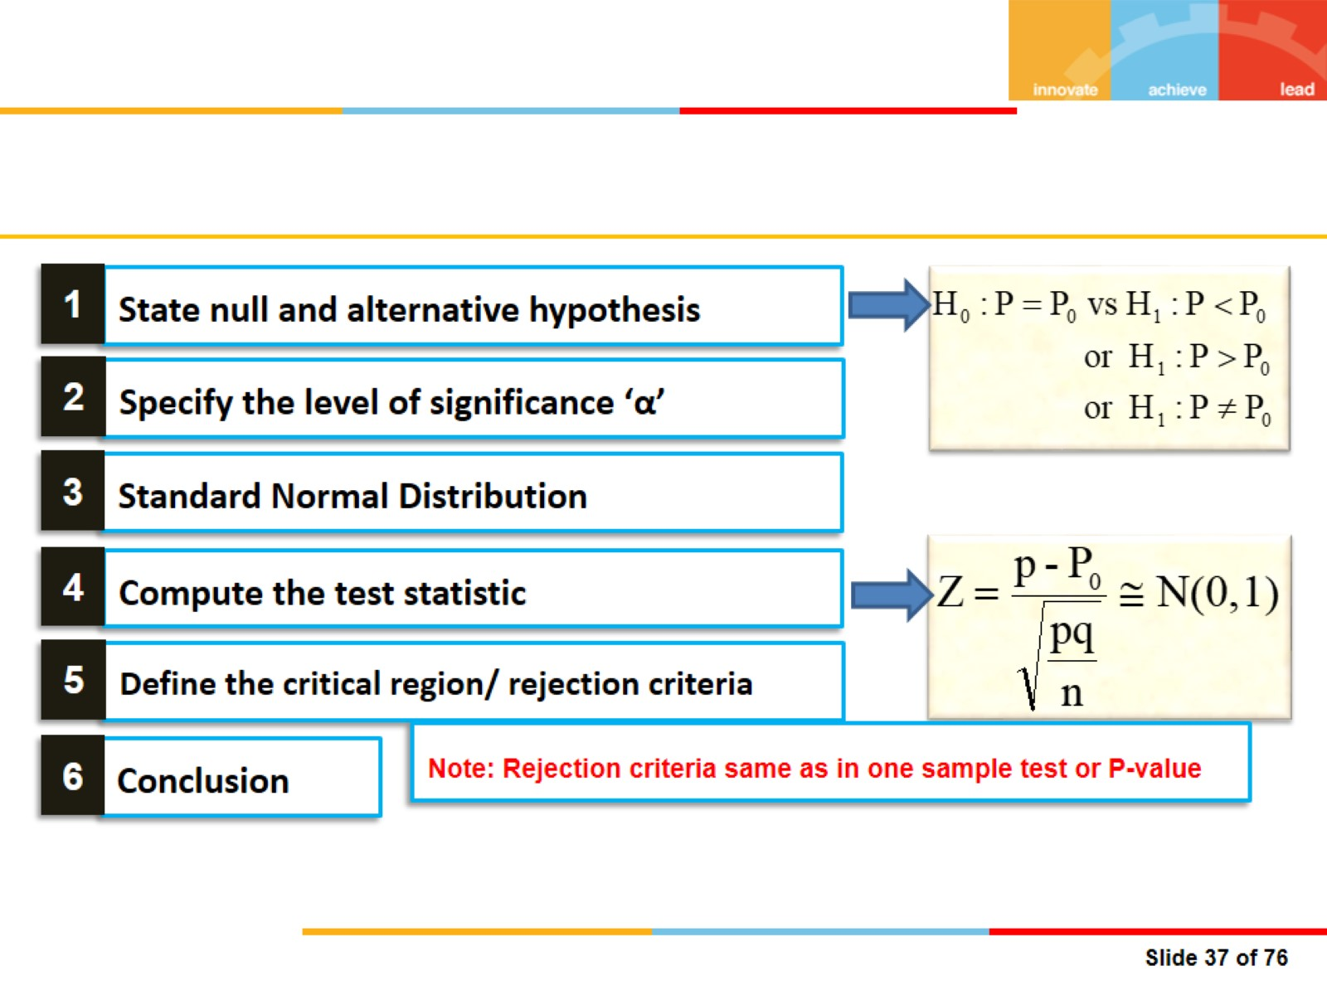

Slide 27


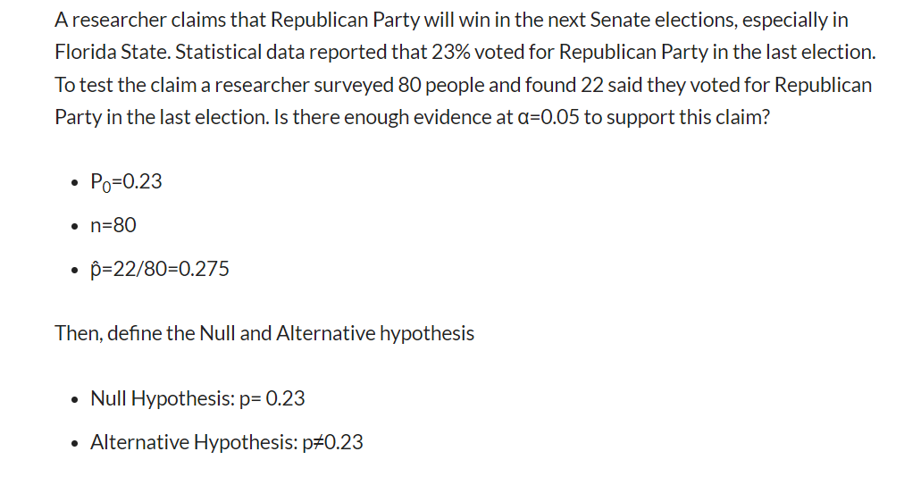

Slide 28
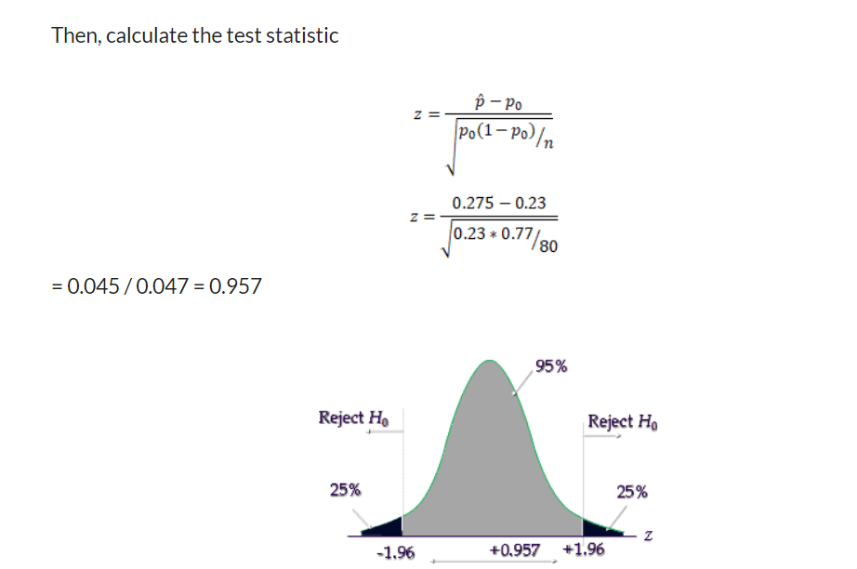
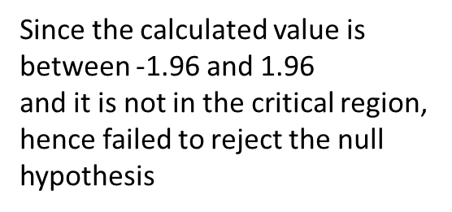

Slide 29
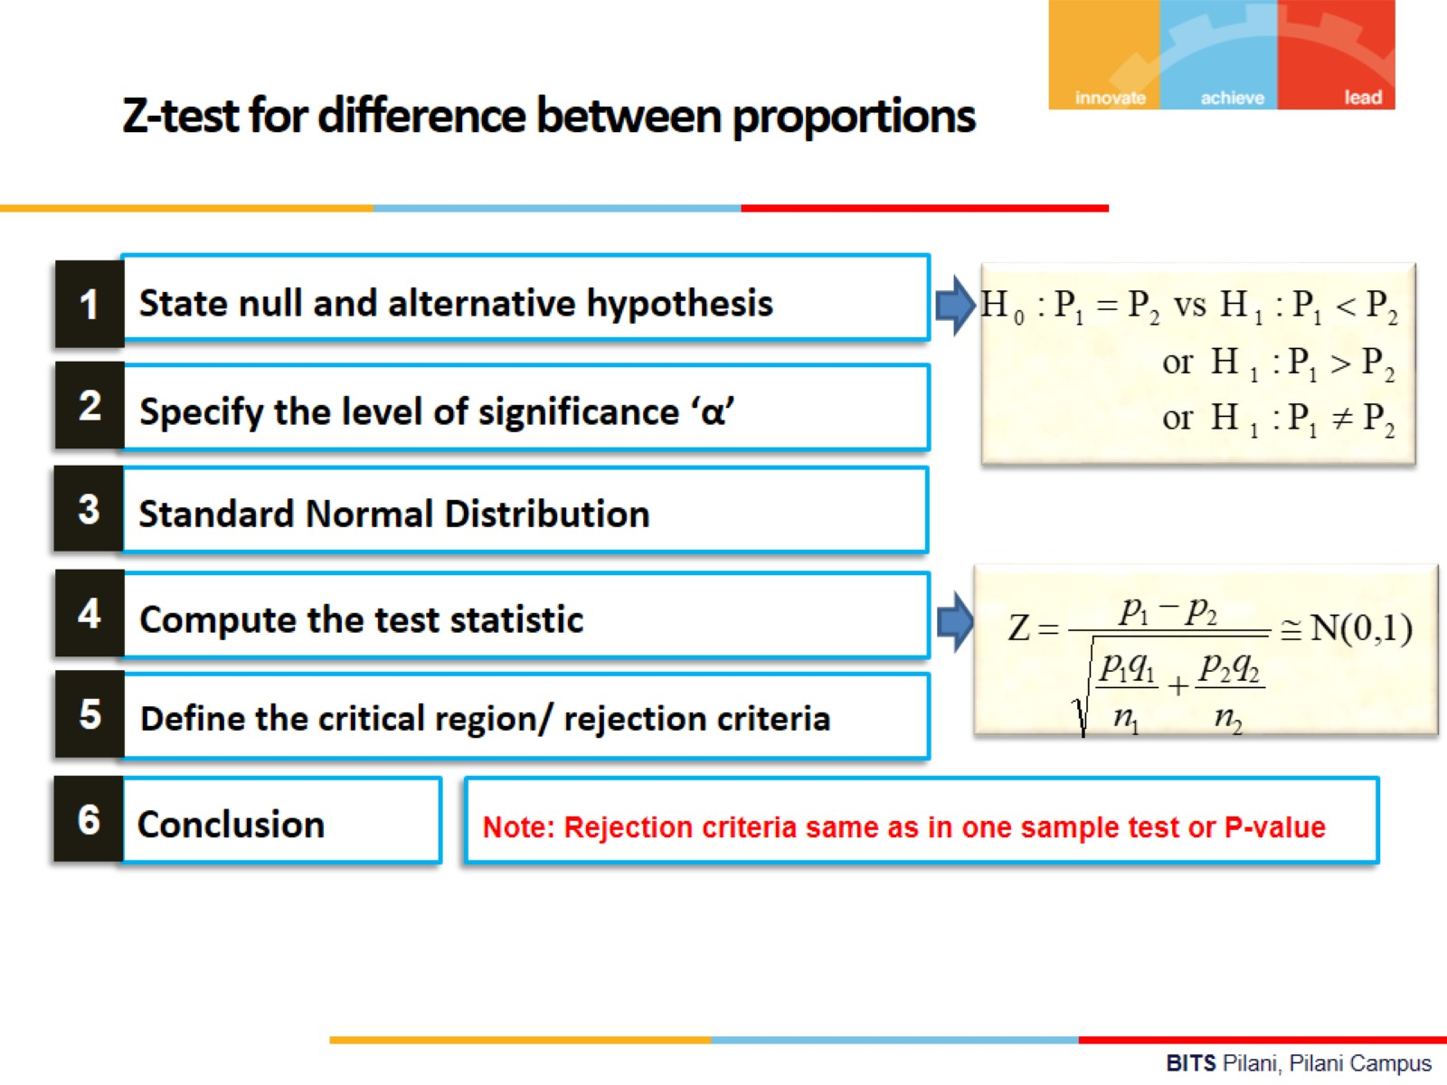

Slide 30
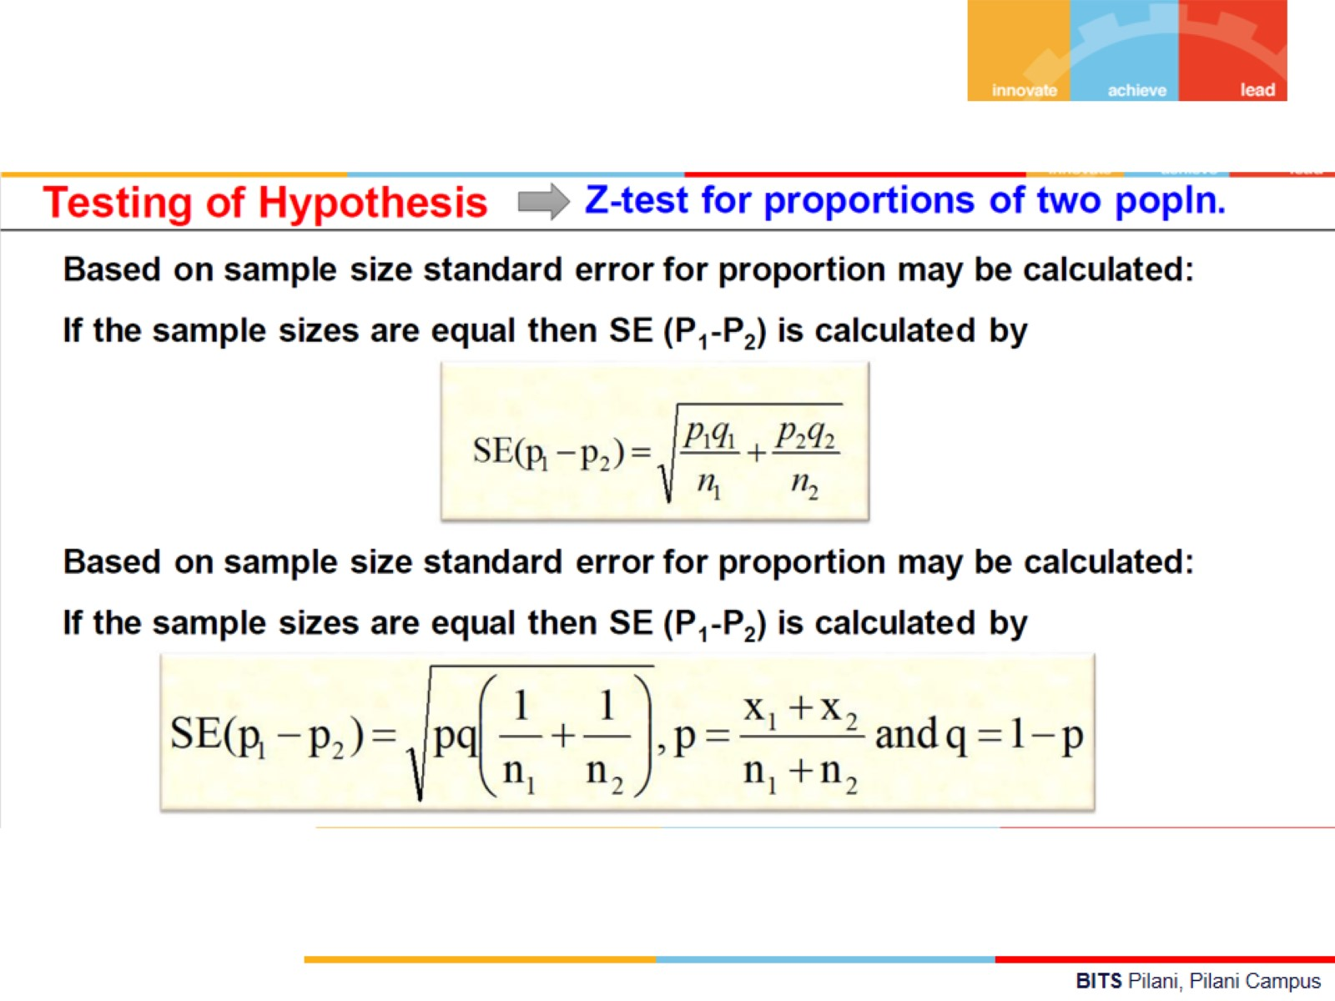

Slide 31
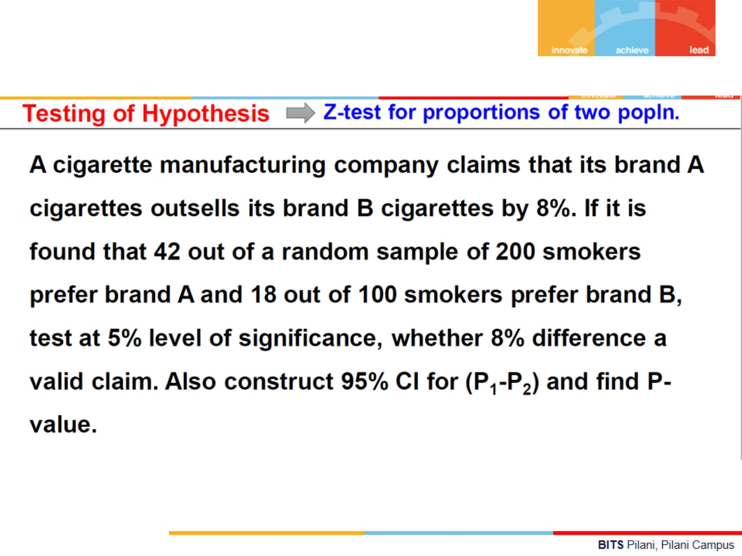

Slide 32
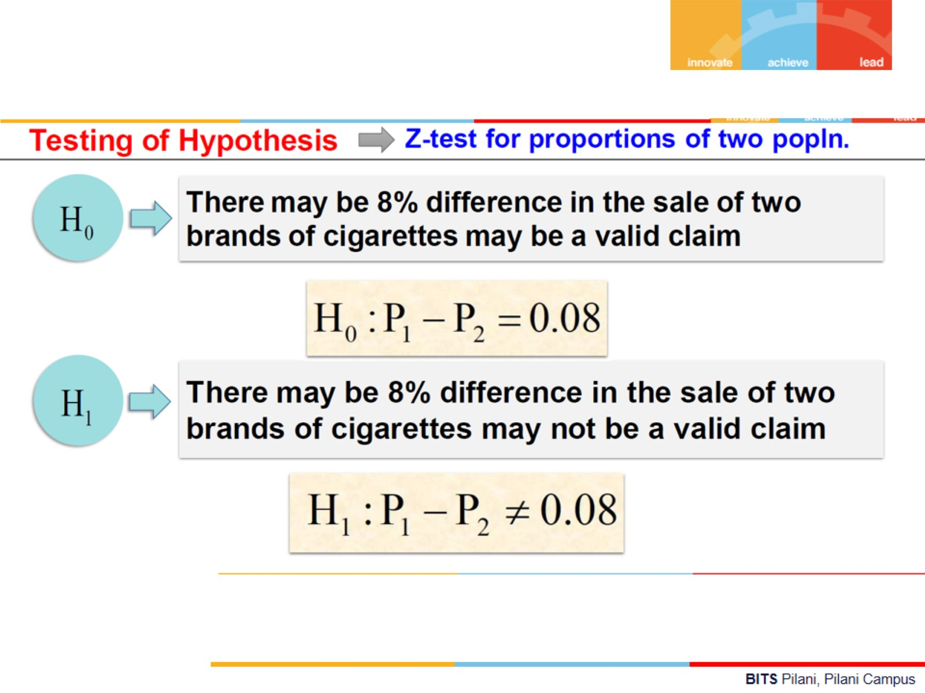

Slide 33
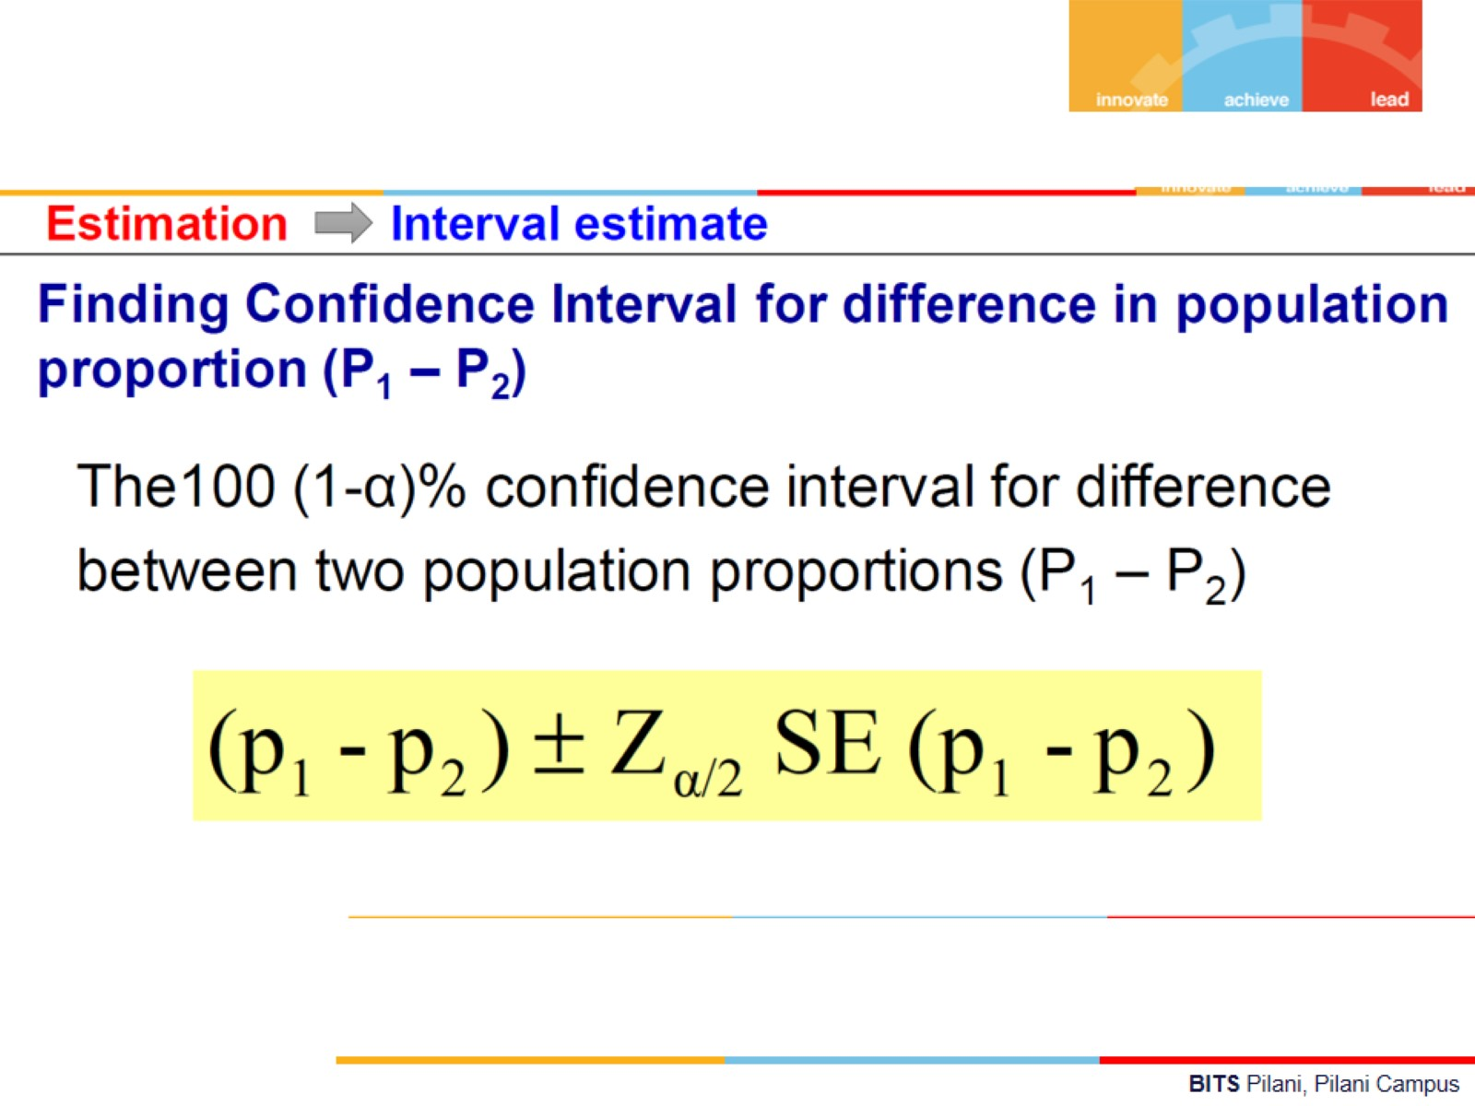

Slide 34
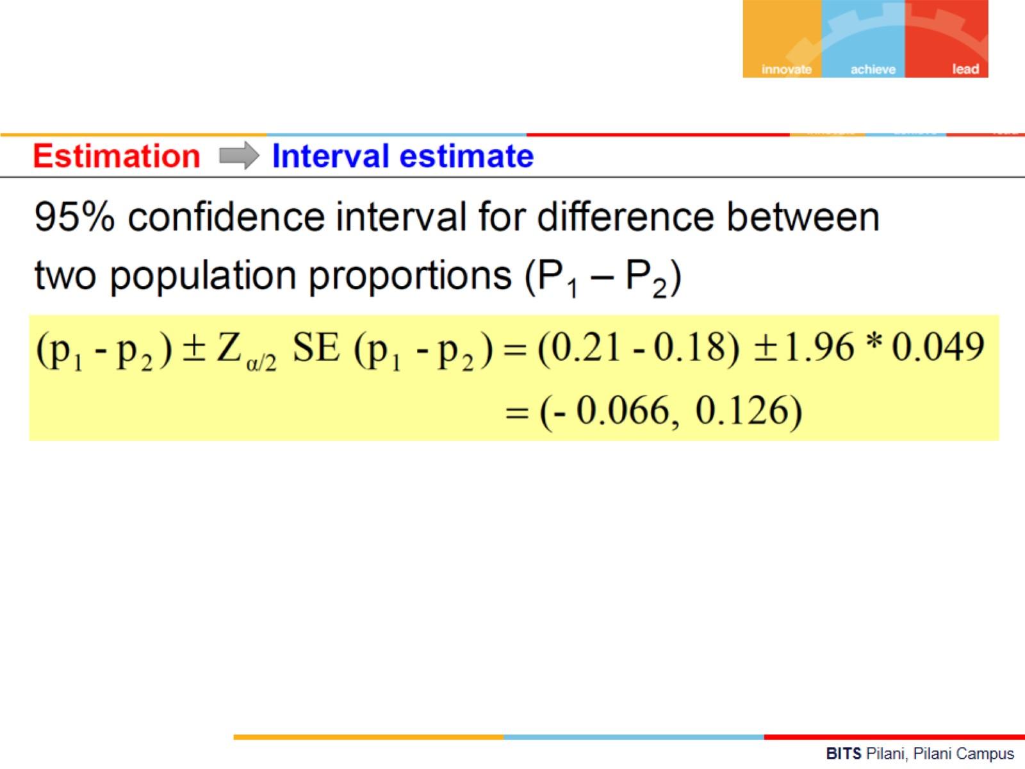

Slide 35
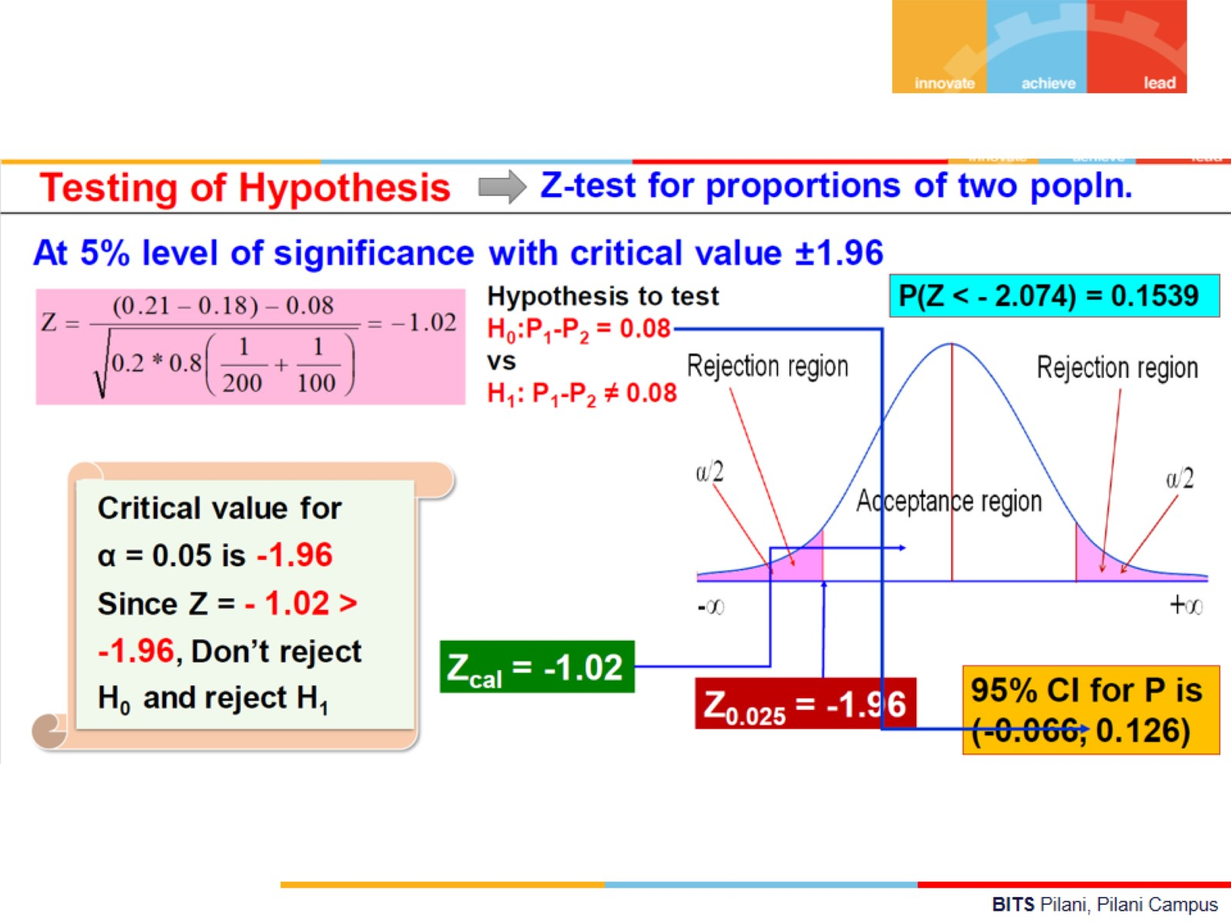

Slide 36
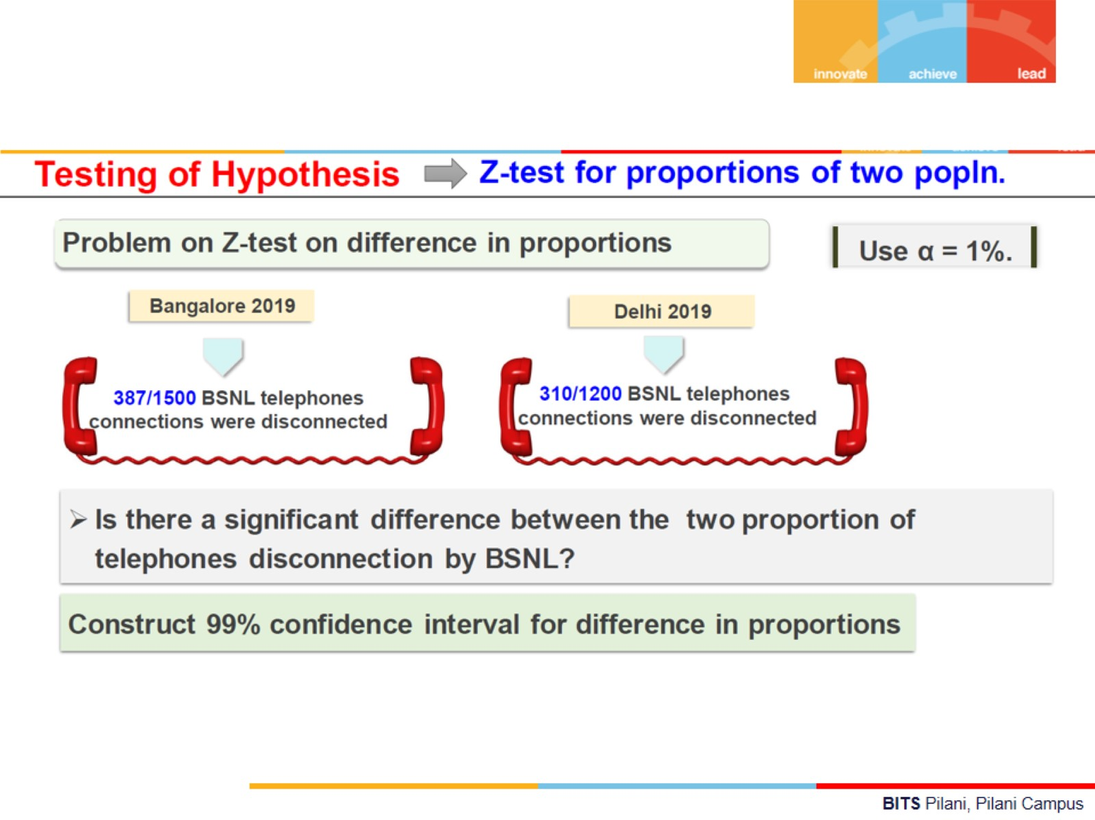

Slide 37
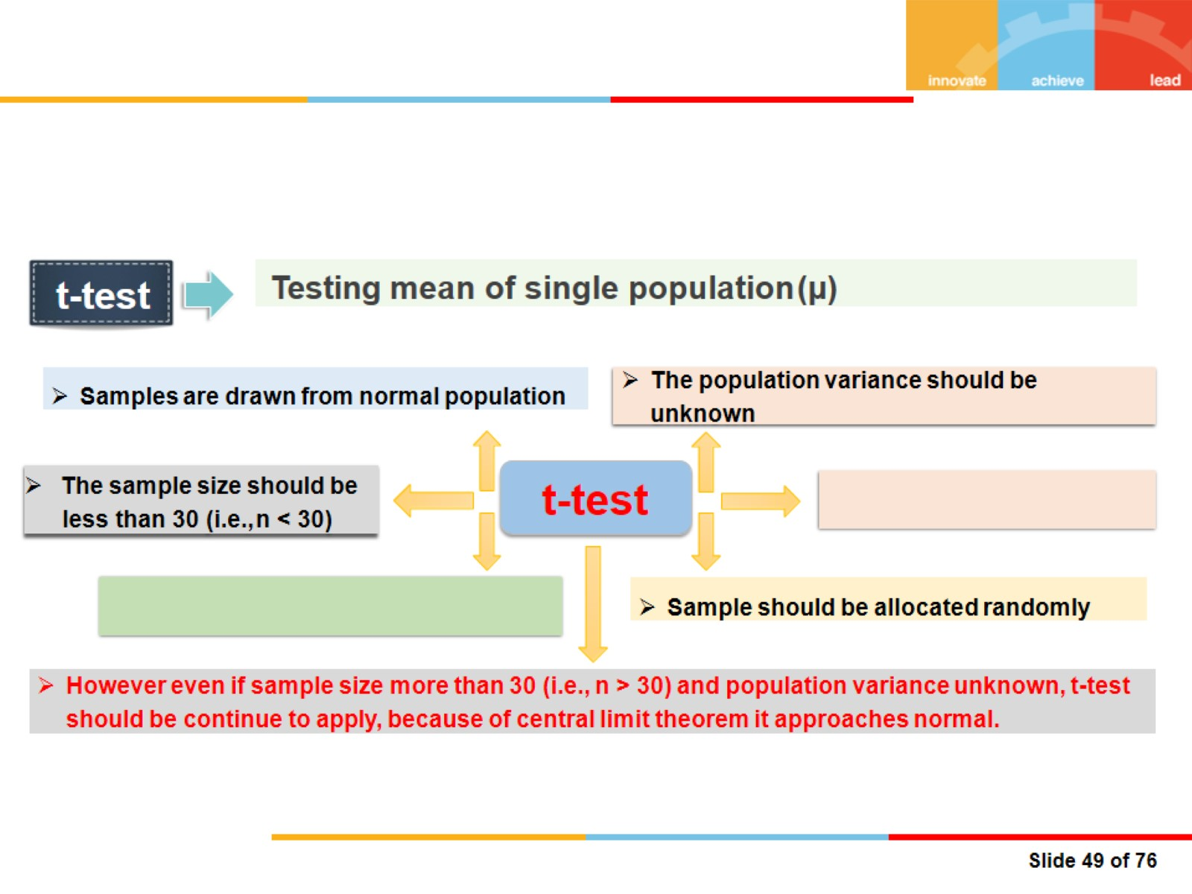


Slide 38
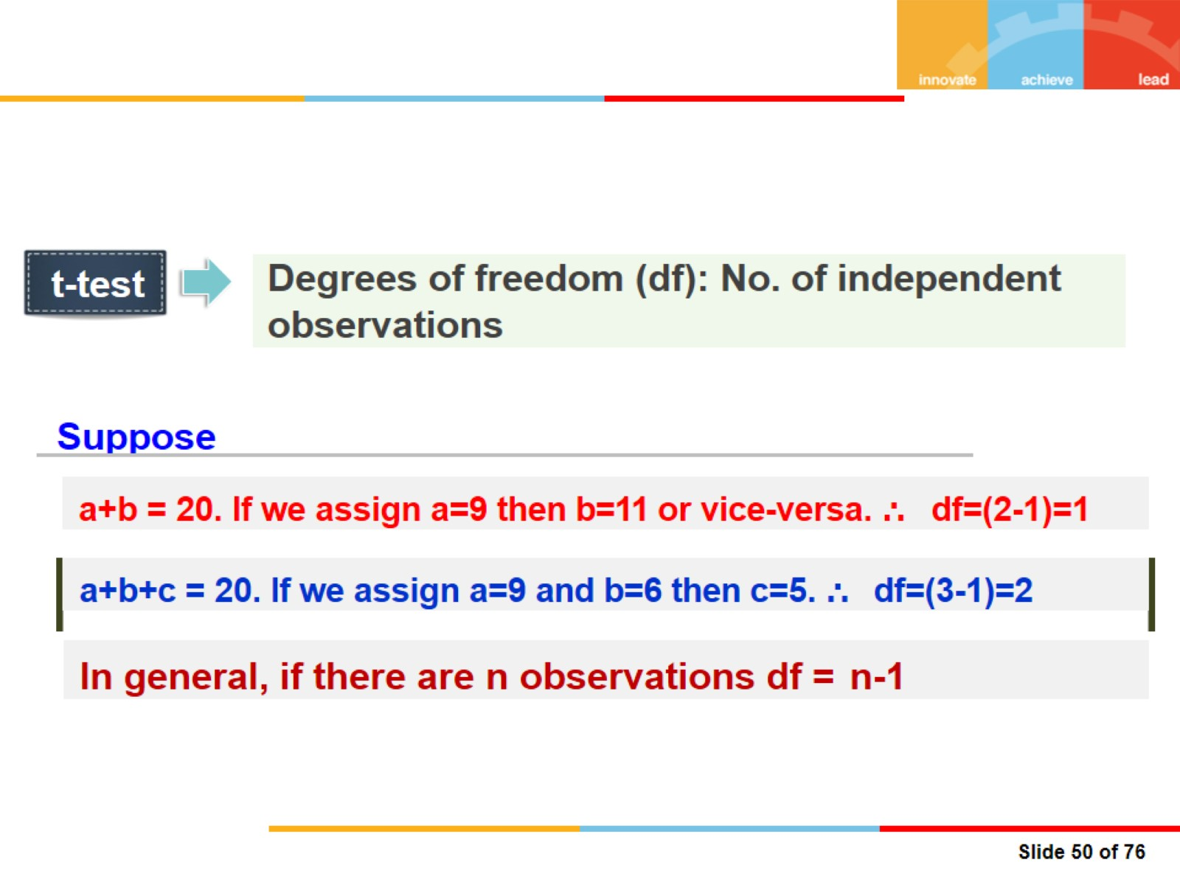

Slide 39
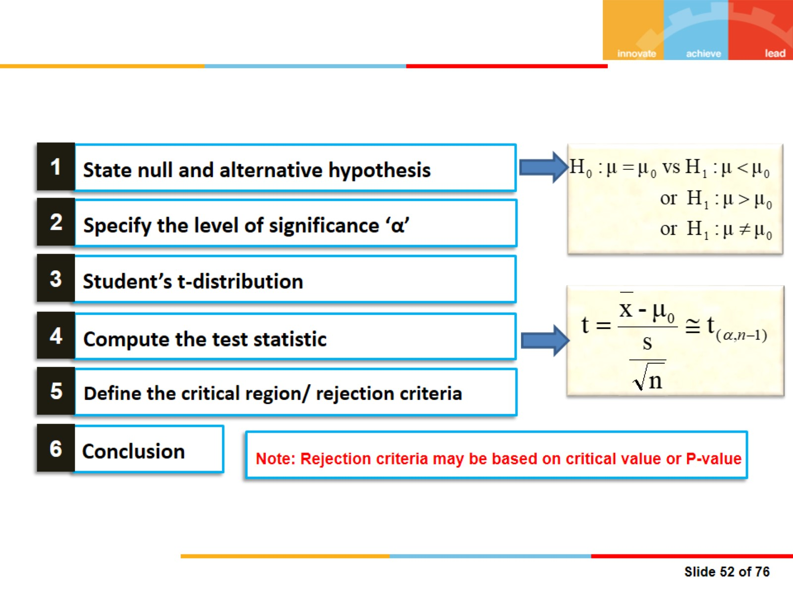

Slide 40
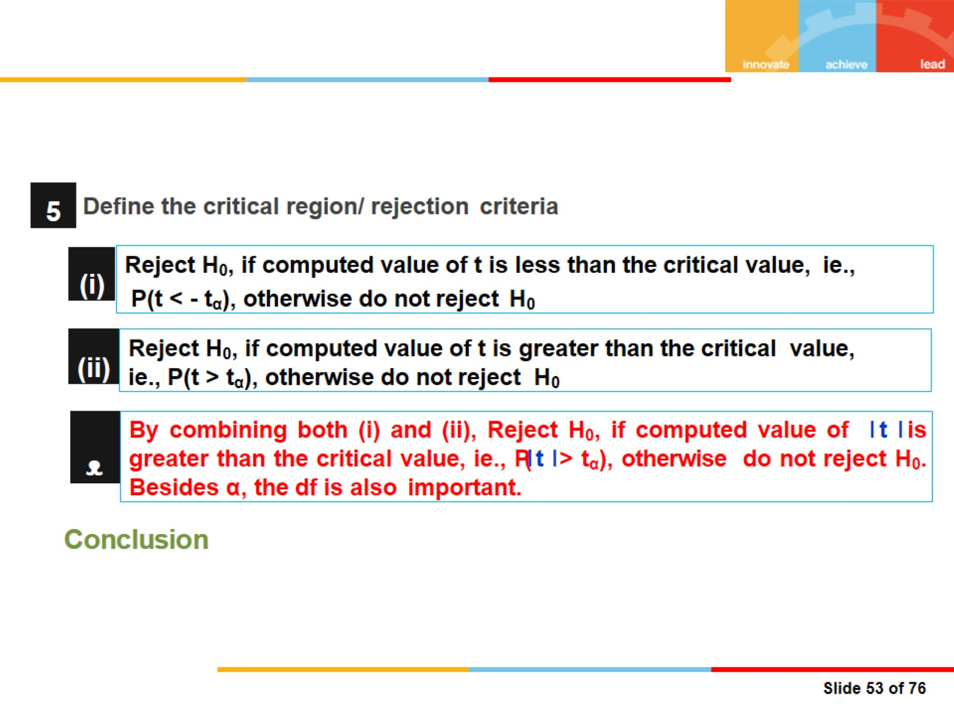

Slide 41
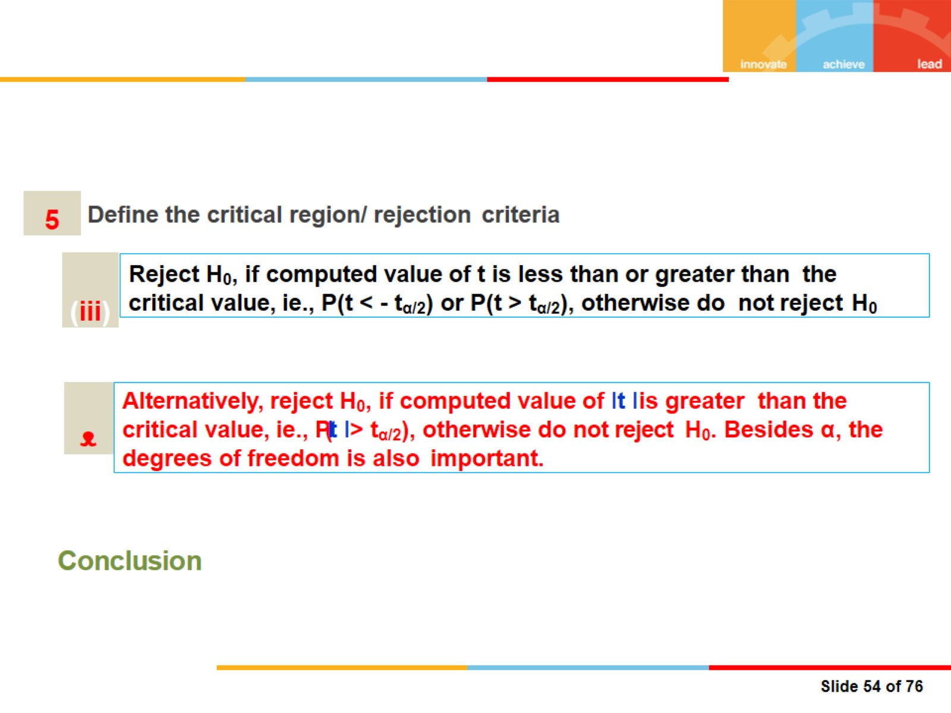

Slide 42
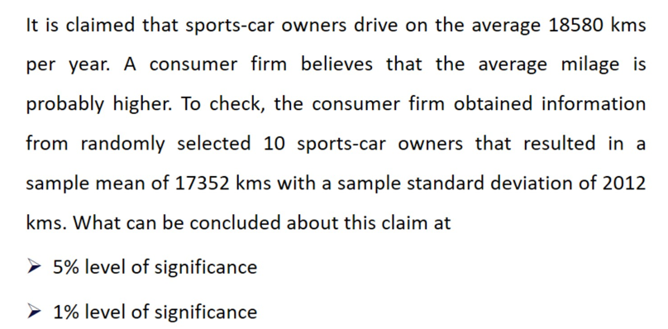
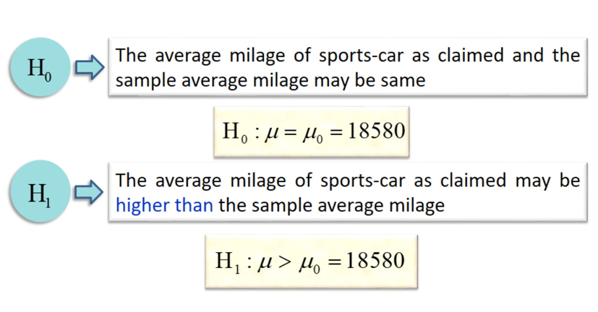
Example

Slide 43
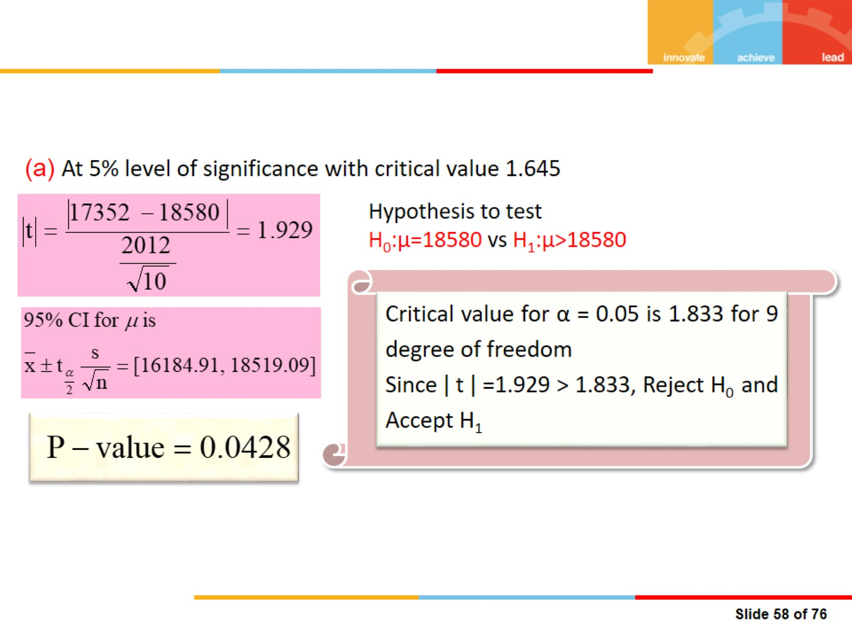

Slide 44
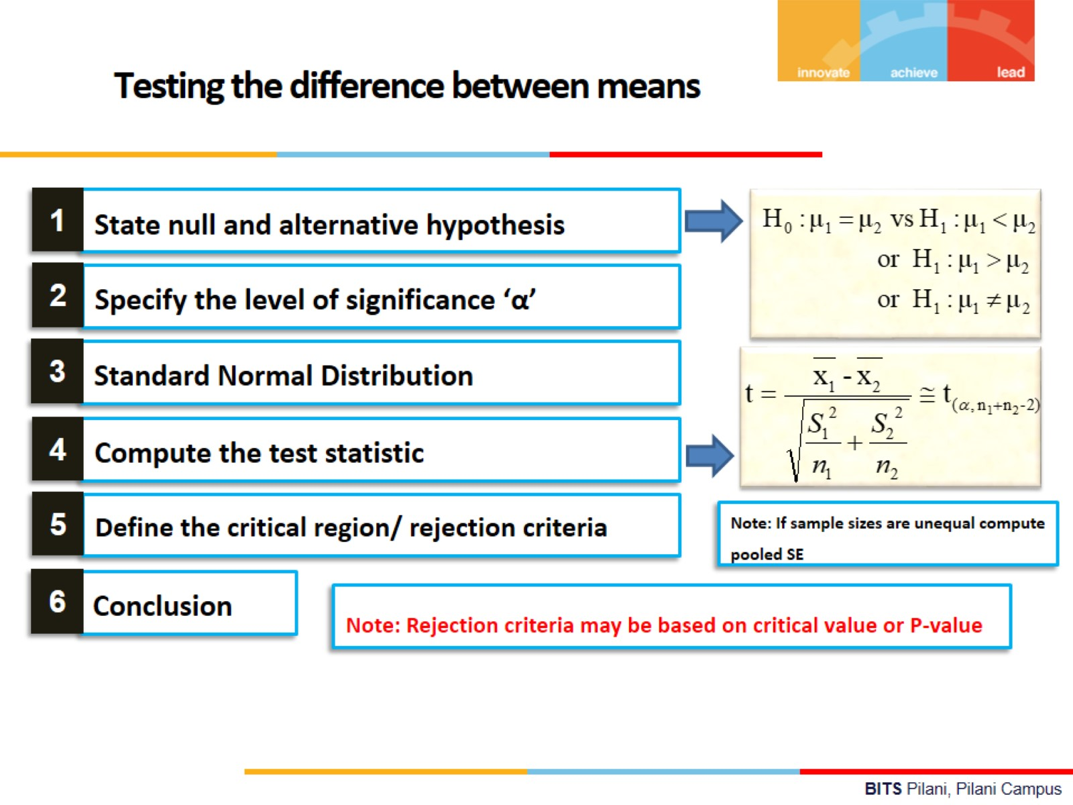

Slide 45
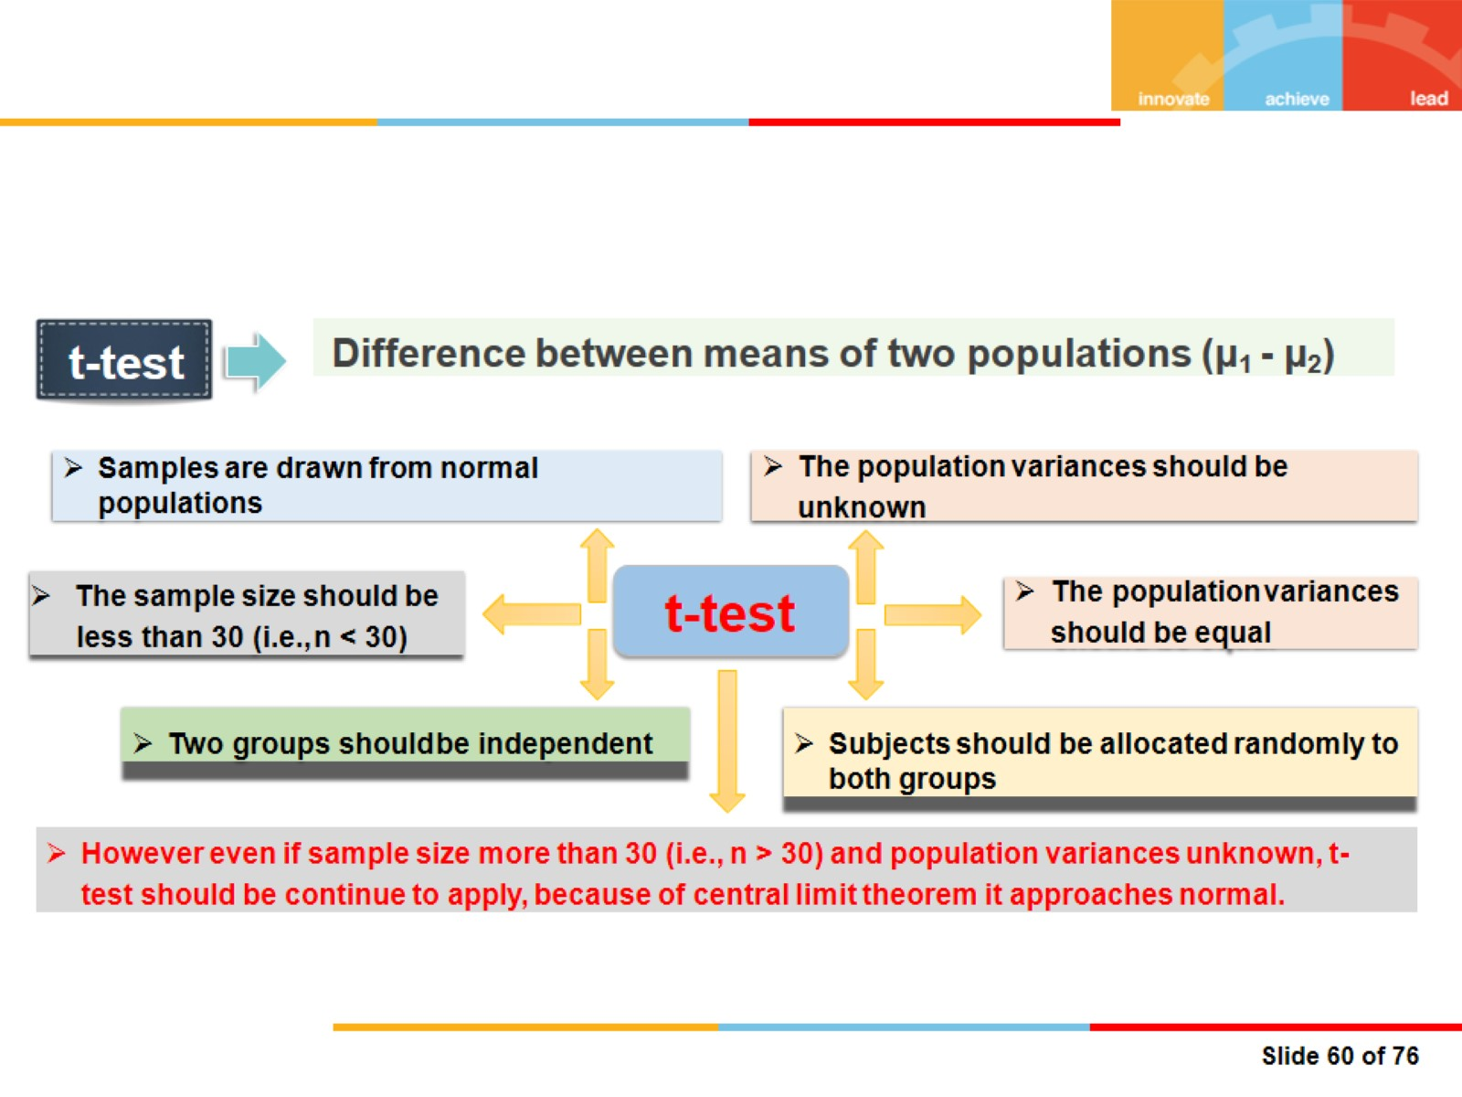

Slide 46


Slide 47


Slide 48


Slide 49


Slide 50


Slide 51


Slide 52


Slide 53


Slide 54



Slide 55


Slide 56


Slide 57


Slide 58


Slide 59


Slide 60

Problem-1

Slide 61

Problem
2

Slide 62

Problem
3

Slide 63

Problem 5

Slide 64

Problem
5

Slide 65

Problem
6

Slide 66

Problem
7

Slide 67


Slide 68


Slide 69


Slide 70


Slide 71


Slide 72


Slide 73


Slide 74


Slide 75


Slide 76


Slide 77


Slide 78


Slide 79


Slide 80


Slide 81


Slide 82


Slide 83


Slide 84


Slide 85


Slide 86


Slide 87


Slide 88


Slide 89


Slide 90


Slide 91


Slide 92


Slide 93


Slide 94


Slide 95

Problem

Slide 96


Slide 97


Slide 98


Slide 99

Hypothesis Testing (Problems for Discussion)

Slide 100


Slide 101


Slide 102


Slide 103

Example

Slide 104

Example

Slide 105

Example

Slide 106


Slide 107


Slide 108


Slide 109


Slide 110

Example

Slide 111

Thanks

